Slide 1
MSc Social Research Methods Pre-sessional Statistics Bootcamp
Burak Sonmez & Dingeman Wiertz
UCL – September 2022

Slide 2
Before We Start
Log into your computer with your SSO
Go to the pre-sessional Moodle page and download:
The slides for this bootcamp
The dataset we will use (“WDI_Data.dta”)
Make sure to save the dataset in an easy-to-access folder
A place you can also access from elsewhere (e.g., N-drive)

Slide 3
Objectives of This Bootcamp
Overarching goal:
Ensuring we have some sort of common starting point + that we are ready to take on the quantitative MSc modules
For this purpose, we will:
Refresh key statistical concepts
E.g., sampling distributions, hypothesis testing
Obtain basic familiarity with Stata

Slide 4
Statistical Inference
Statistical inference is used to learn from incomplete/imperfect data
One way of thinking about statistical inference:
We wish to learn some characteristics of a population (e.g., the mean and standard deviation of the heights of all women in the UK), which we must estimate from a sample or subset of that population
Two types of statistical inference:
Descriptive inference: What is going on, or what exists?
Causal inference: Why is something going on, why does it exist?

Slide 5
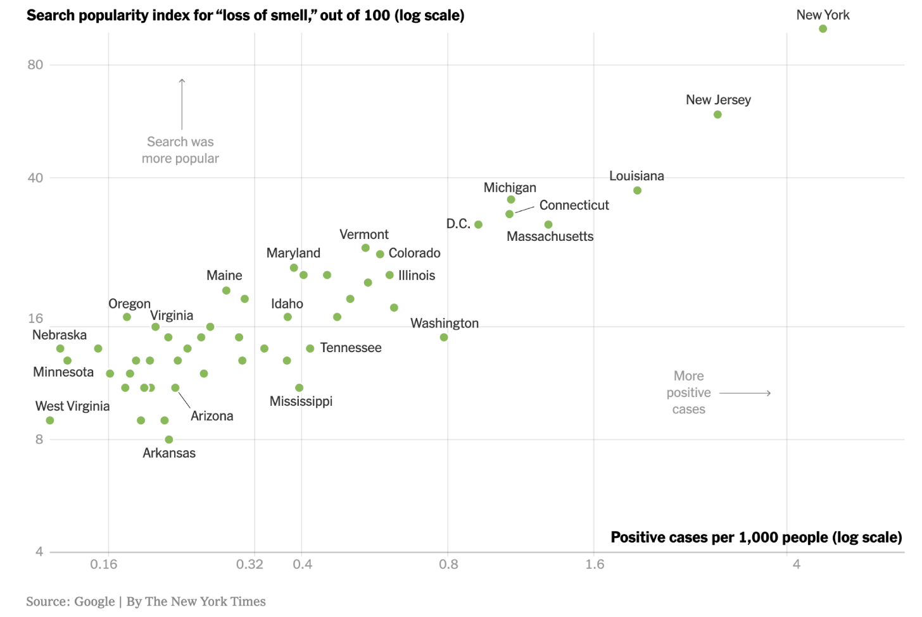
Descriptive vs. Causal Inference
Descriptive inference: Does the search popularity of “loss of smell” increase as Covid cases are higher?

Slide 6
Descriptive vs. Causal Inference
Causal inference: Why do people search more for “loss of smell” in some American states than in others?

Slide 7
Variables and Observations
A variable is anything that can vary across units of analysis:
It is a characteristic that can have multiple values / categories
E.g., sex, age, diameter, financial revenue, temperature
A unit of analysis is the major entity that you are analyzing:
E.g., individuals, objects, schools, countries
An observation is the value of a particular variable for a particular unit (sometimes a unit is in its entirety referred to as observation)
E.g., King Charles III is 73 years of age

Slide 8
Different Types of Variables
Continuous / interval-ratio variables:
They have an ordering, they can take on infinitely many values, and you can do calculations with them
E.g., income, age, weight, time
Categorical variables:
Each observation belongs to one out of a fixed number of categories
Ordinal variables: there is a natural ordering of the categories
Nominal variables: there is no natural ordering of the categories
E.g., education level, Likert scales, gender, vote choice

Slide 9
Introducing Stata
Stata is a powerful software package that allows you to do:
Data management and manipulation
Data visualization
Statistical analysis
Stata has a compact command syntax that facilitates reproducibility
Other tools to conduct data analysis include R: a programming language and environment for statistical computing and graphics
To some degree, Stata skills are transferable to such alternative platforms

Slide 10
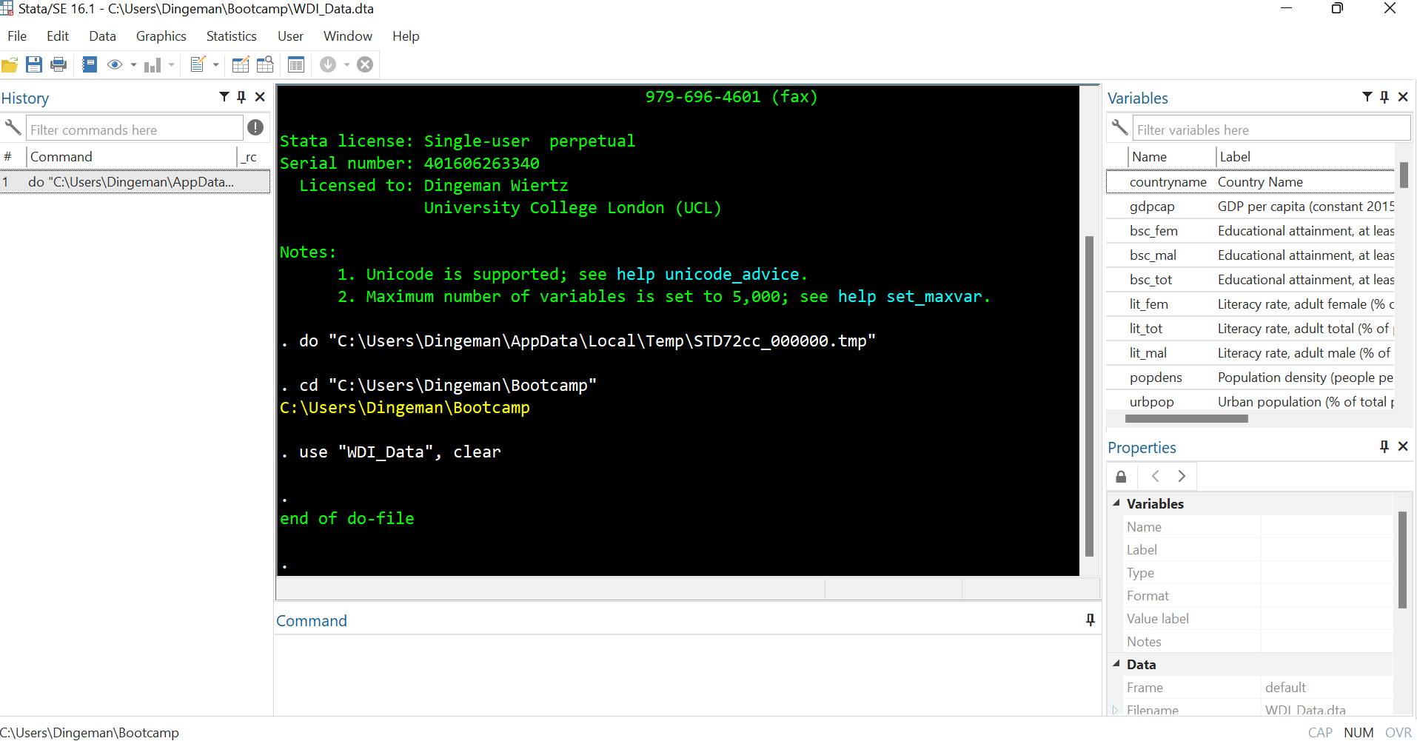
Stata’s Interface: Variables Window
The variables window displays all variables in your dataset
Single click on variable names to see details in properties window
Double click to make variables appear in command window

Slide 11
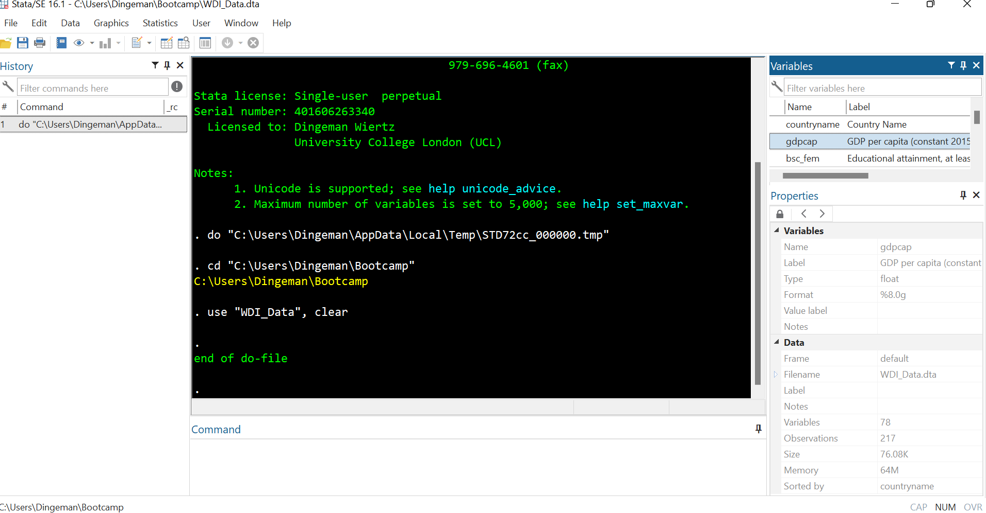
Stata’s Interface: Properties Window
The properties window displays details about selected variables as well as the entire dataset (e.g., number of observations, sort order)

Slide 12
Stata’s Interface: Command Window
The command window is for entering and executing commands
But it is better to use do-files (same applies to drop-down menus)

Slide 13
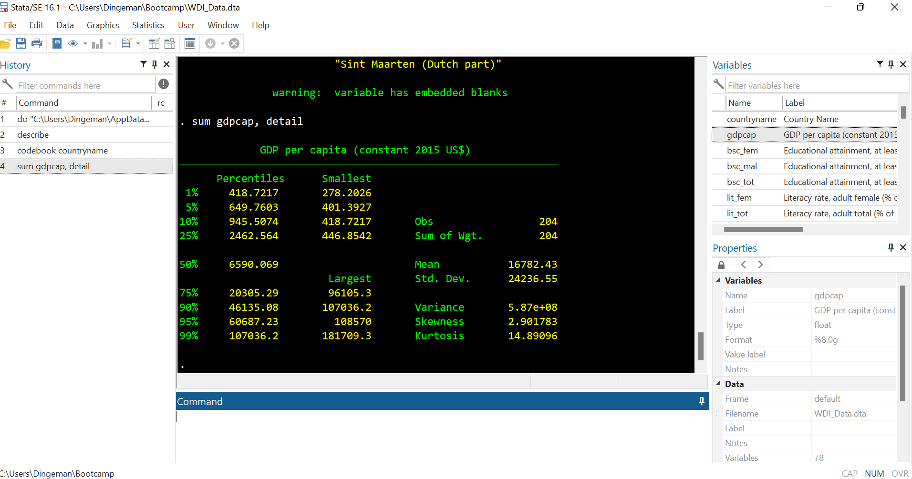
Stata’s Interface: Results Window
The results window displays all output of your commands
To change colour scheme: Select Edit from drop-down menu → Preferences → General preferences → Results → Classic

Slide 14
Stata’s Interface: Command History and Current Working Directory
The command history window lists previously run commands
At the bottom you can see the current working directory: the folder where any files will be loaded from and saved to

Slide 15
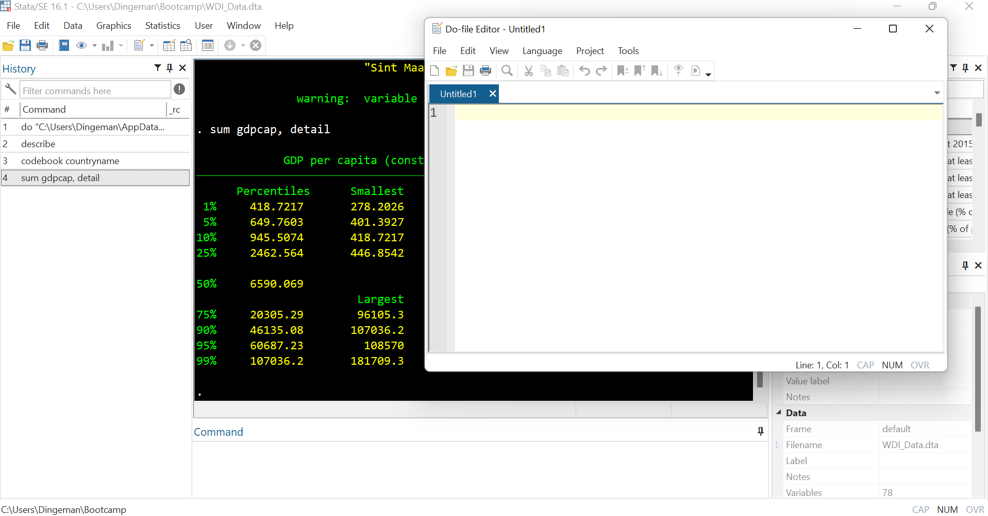
Stata’s Interface: Opening a Do File
Do files are text files where you can store commands for reuse
Huge payoffs for reproducibility, debugging, adapting commands

Slide 16
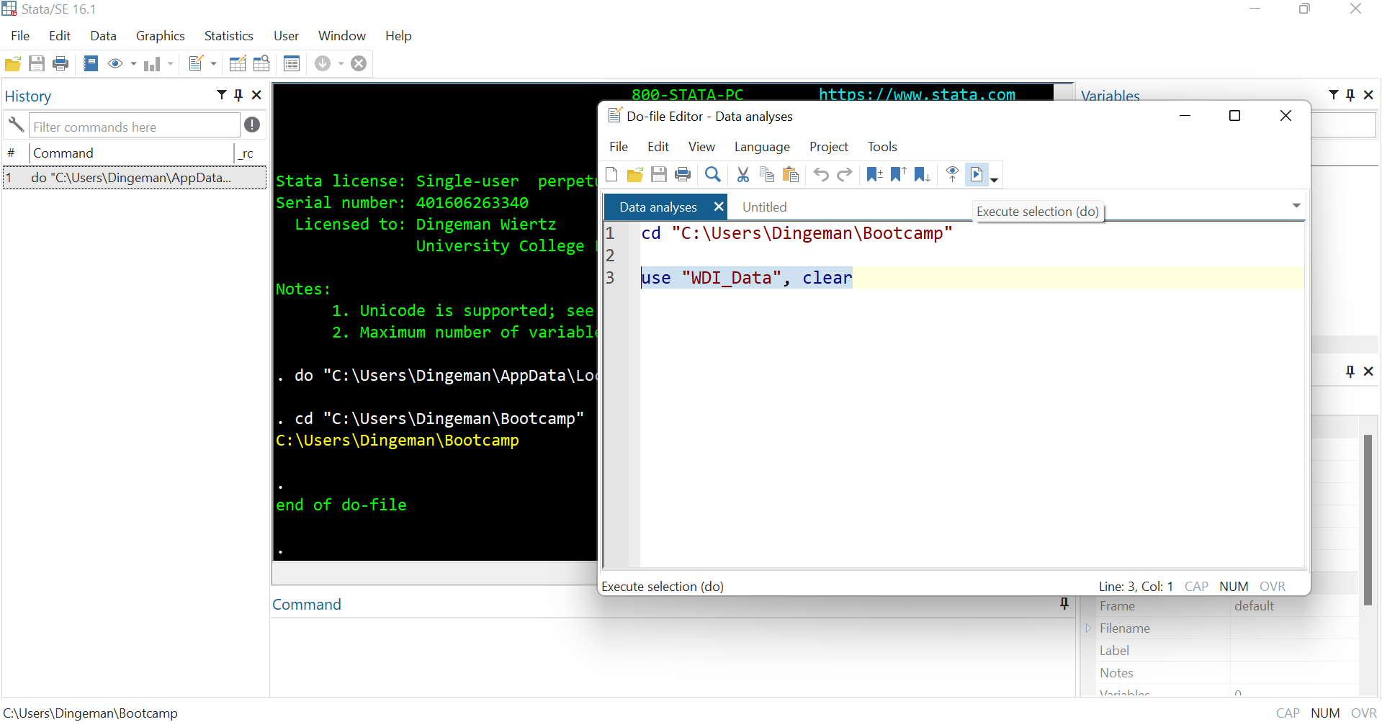
Running Commands from a Do File
After entering a command, you select it, and then click the “execute” button or press “Ctrl+D”

Slide 17
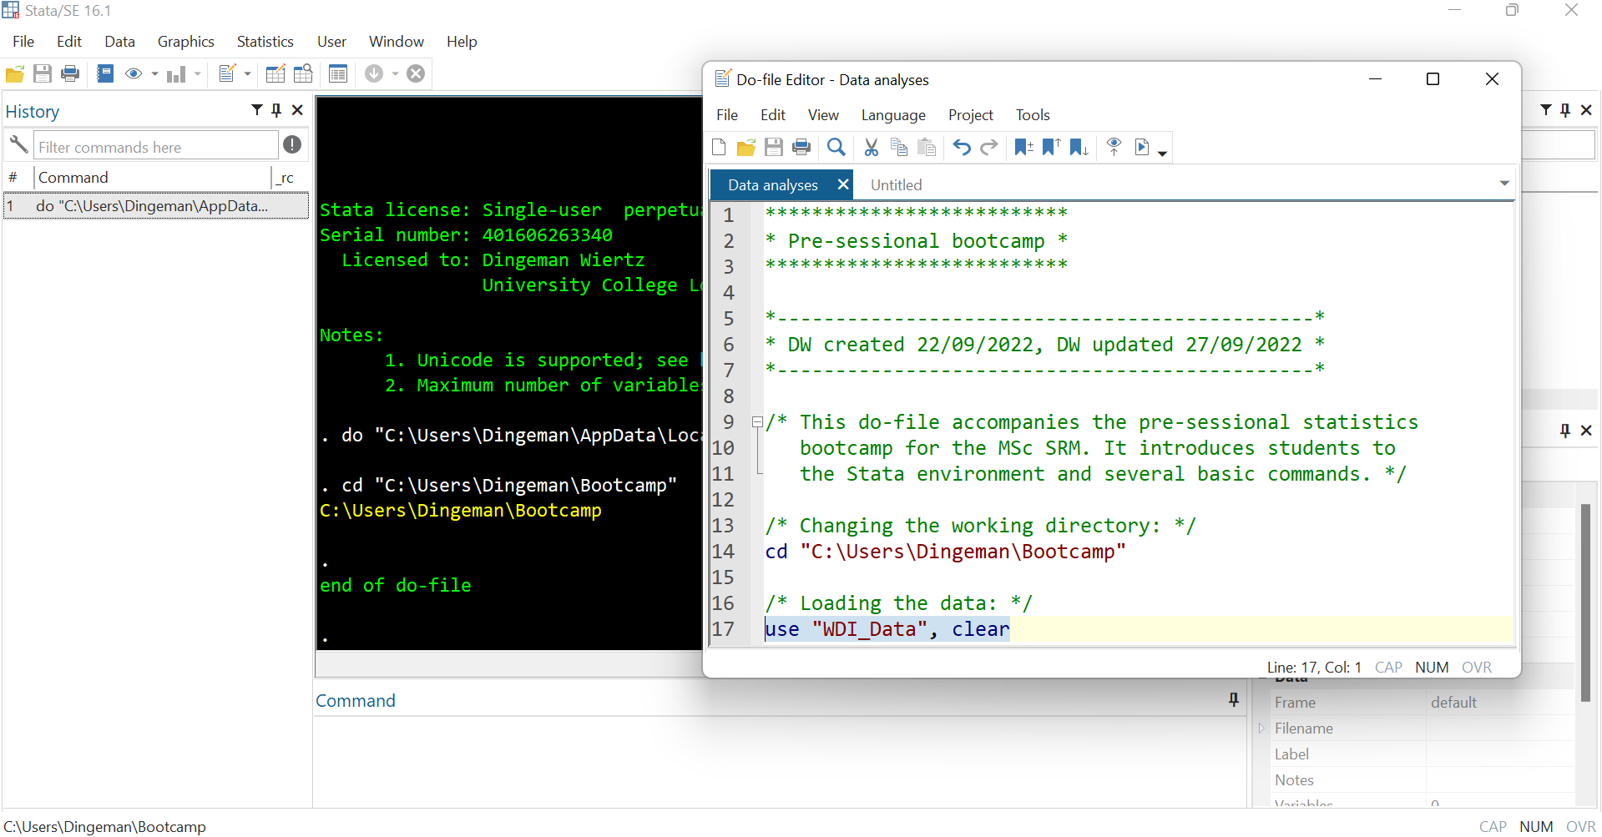
Do File Dos and Don’ts
Use annotations to facilitate replicability (incl. for future self!):
Use * for single-line comments and /* */ for multiple lines
Notes:
When running do-files, Stata will ignore whatever is marked as an annotation.

Slide 18
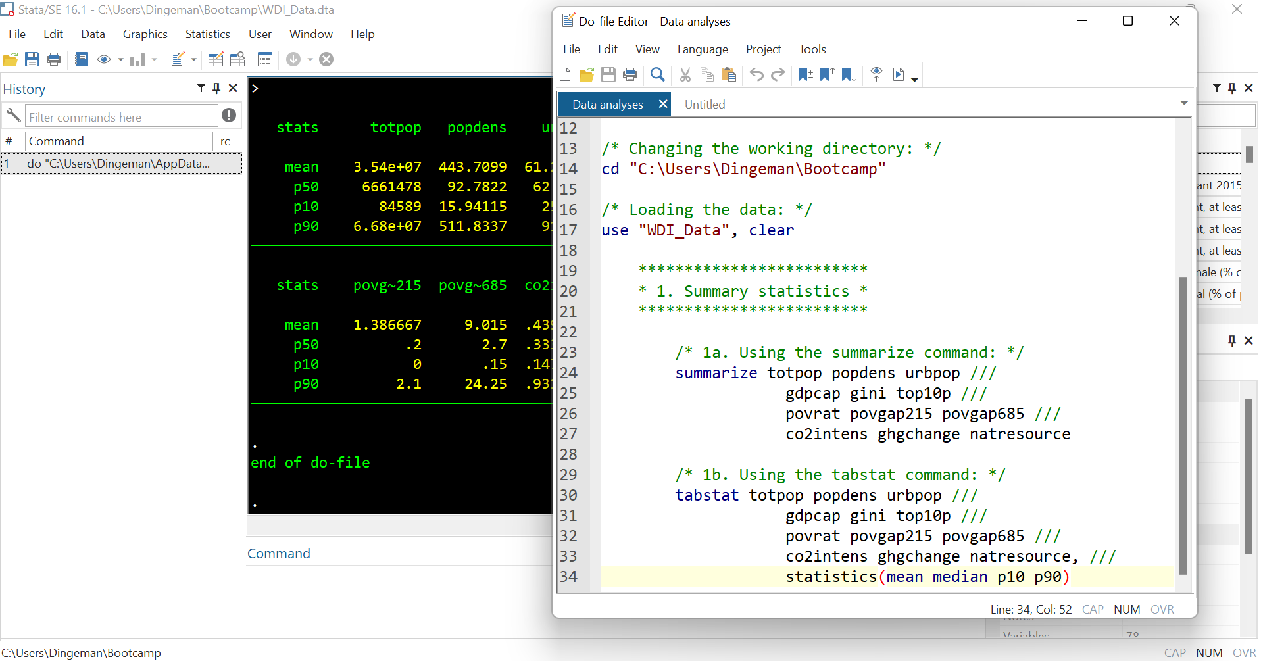
Do File Dos and Don’ts
Break down code into clearly labelled sections / subsections
Use tab indentations to making things easy to read

Slide 19
Do File Dos and Don’ts
Don’t put too much information on a single line:
Use /// to continue your command on the next line and write “top-to-bottom” instead of “left-to-right”
Notes:
Do not forget to insert a blank space before the triple slash, or you will receive an error message when running the command.

Slide 20
Now Have a Look Around Yourself…
Useful commands to get started:
cd: sets your working directory
Where any data will be loaded from and saved to
E.g., cd "C:\Users\Dingeman\Bootcamp"
use: opens a stored dataset
Dataset needs to be in .dta format
Add clear option if you already had another dataset open
E.g., use "WDI_Data", clear
Notes:
Pick your working directory wisely.
Stata can only deal with one dataset at a time.
Stata can also import other file types (e.g., .xls or .csv): import excel & import delimited.

Slide 21
Now Have a Look Around Yourself…
Useful commands to get started:
describe: provides a description of variables
If you specify no variables, the command will be applied to all
E.g., describe forest co2intens or describe
codebook: examines labels, data etc. to produce a codebook
If you specify no variables, command will be applied to all
E.g., codebook countrycode femparl or codebook

Slide 22
Now Have a Look Around Yourself…
Some questions to guide your explorations:
How many variables are there in this dataset?
How many countries are identified in this dataset?
For which continent do we observe the most countries and for which continent the fewest?
What are the labels of the variables femmanage and armyexp?
How many missing values do femmanage and armyexp have?
What are the means for femmanage and armyexp?
Which countries have the highest scores for femmanage and armyexp?
Notes:
Our dataset is an extract (for 2019) from the World Development Indicators database from the World Bank:
https://datatopics.worldbank.org/world-development-indicators/

Slide 23
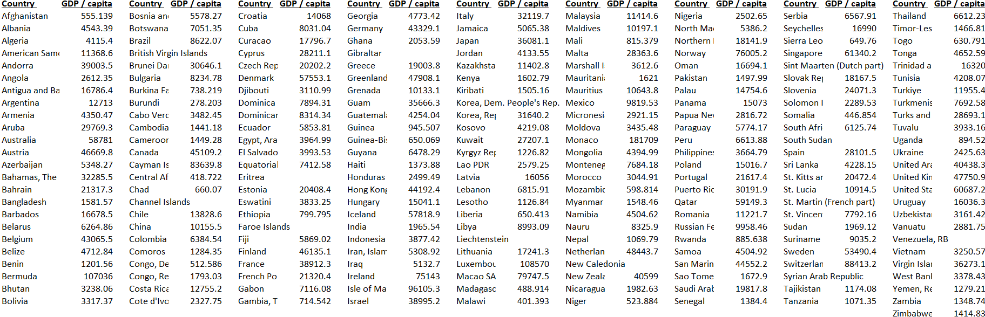
Describing Data
Describing data is necessary because there is usually too much of it, so it does not make any sense by itself
E.g, what can you say about the world income distribution based on this table?

Slide 24
Describing Data
Describing data is necessary because there is usually too much of it, so it does not make any sense by itself
We thus have to look for ways to summarize central tendencies, variation, and relationships that exist in the data
There are many different ways to do this
Numerical descriptions
Visual depictions

Slide 25
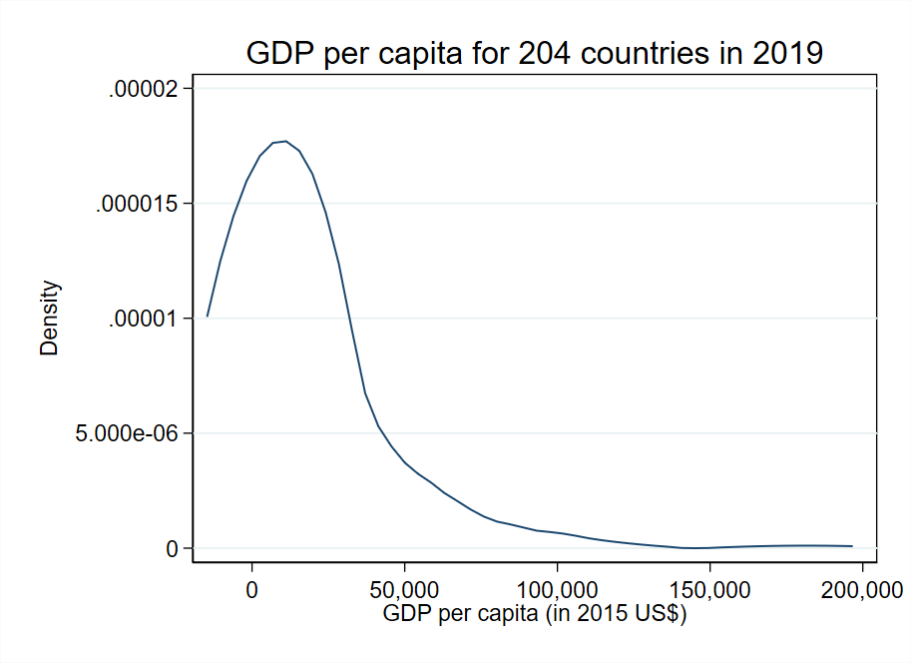
Distributions
Variables can be characterized by their frequency distribution:
The distribution of the (relative) frequencies of their values
In a sample or in the population
E.g., we can graph the world income distribution:

Slide 26
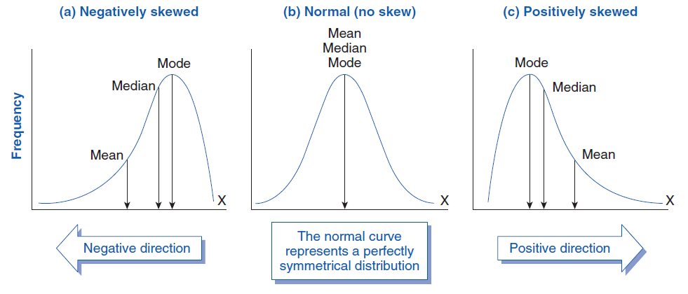
Distributions
Distributions can take on many different shapes; some examples:

Slide 27
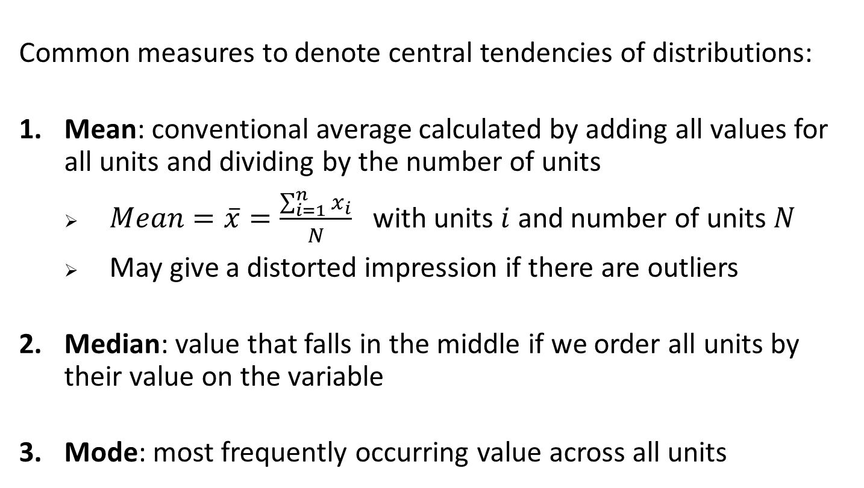
Measures of Central Tendency
Common measures to denote central tendencies of distributions:
Mean: conventional average calculated by adding all values for all units and dividing by the number of units
$Mean=\overline{x}=\frac{\sum_{i=1}^{n}{x_{i}}}{N}$ with units $i$ and number of units $N$
May give a distorted impression if there are outliers
Median: value that falls in the middle if we order all units by their value on the variable
Mode: most frequently occurring value across all units

Slide 28
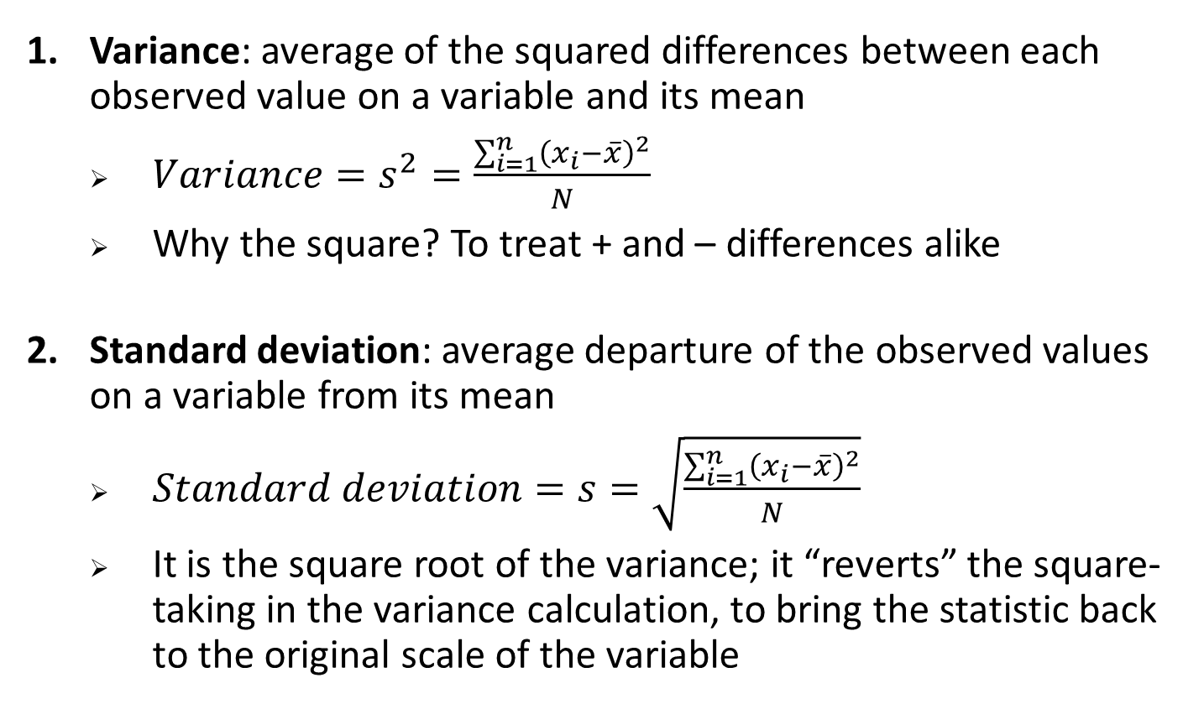
Measures of Dispersion / Spread
Variance: average of the squared differences between each observed value on a variable and its mean
$Variance=s^{2}=\frac{\sum_{i=1}^{n}{{\left(x_{i}−\overline{x}\right)}^{2}}}{N}$
Why the square? To treat + and – differences alike
Standard deviation: average departure of the observed values on a variable from its mean
$Standard deviation=s=\sqrt{\frac{\sum_{i=1}^{n}{{\left(x_{i}−\overline{x}\right)}^{2}}}{N}}$
It is the square root of the variance; it “reverts” the square-taking in the variance calculation, to bring the statistic back to the original scale of the variable

Slide 29
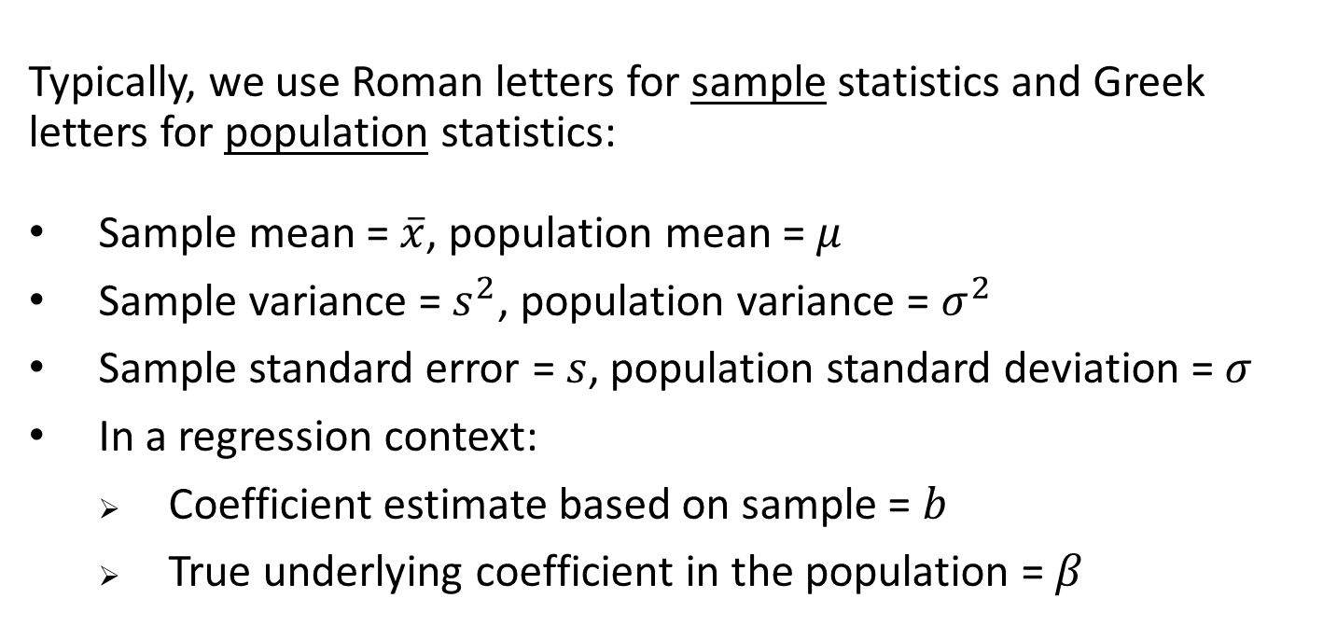
A Note on Notation
Typically, we use Roman letters for sample statistics and Greek letters for population statistics:
Sample mean = $\overline{x}$, population mean = $μ$
Sample variance = $s^{2}$, population variance = $σ^{2}$
Sample standard error = $s$, population standard deviation = $σ$
In a regression context:
Coefficient estimate based on sample = $b$
True underlying coefficient in the population = $β$
Recall: the sample is what we observe, the population is what we want to make inferences about

Slide 30
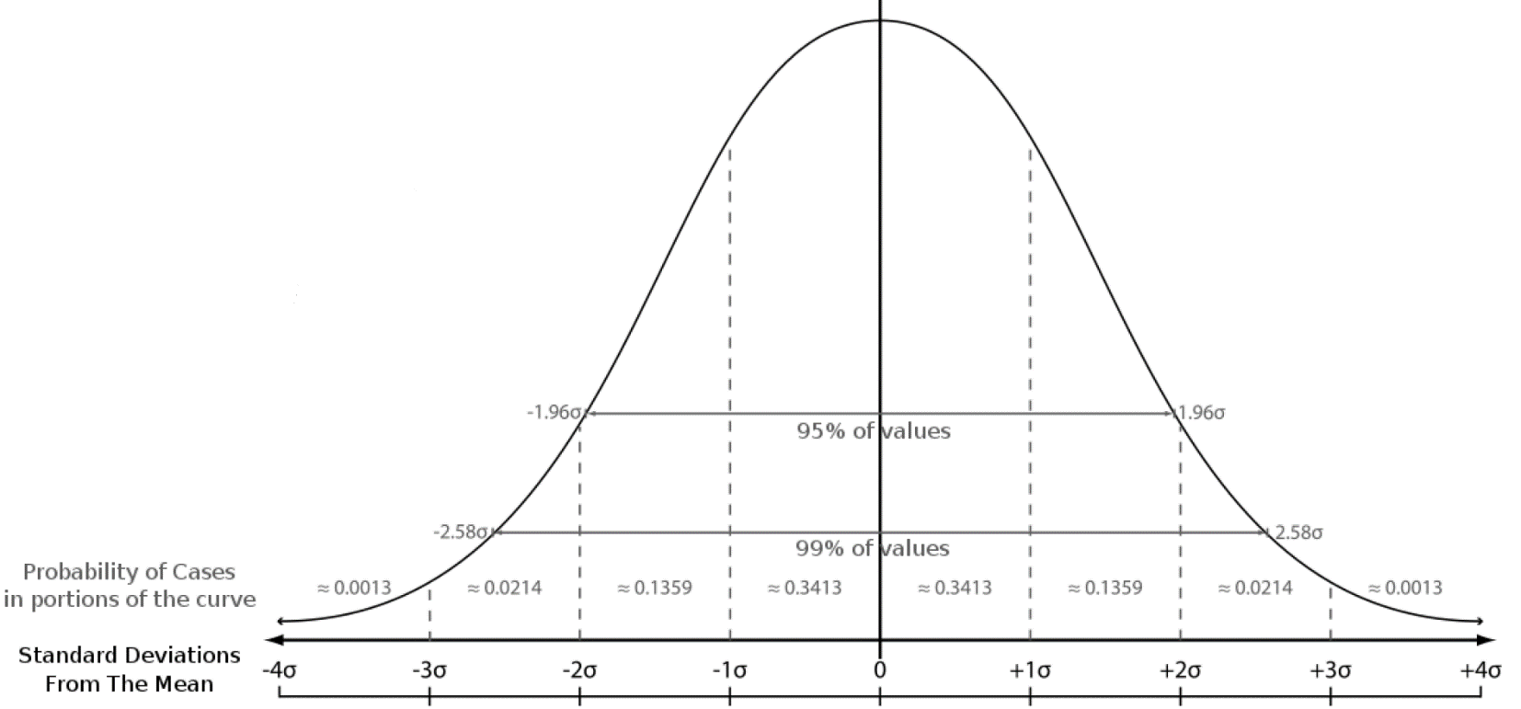
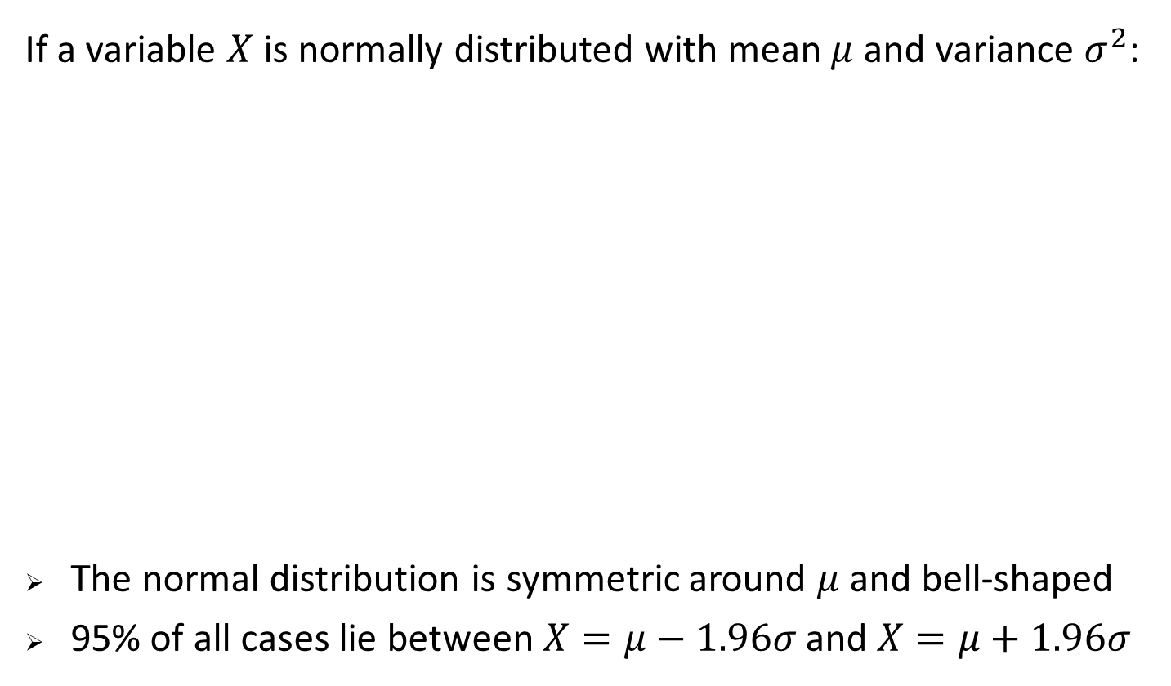
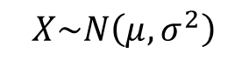
The Normal Distribution
If a variable $X$ is normally distributed with mean $μ$ and variance $σ^{2}$:
The normal distribution is symmetric around $μ$and bell-shaped
95% of all cases lie between $X=μ−1.96σ$ and $X=μ+1.96σ$
Horizontal axis: value of variable
Vertical axis: probability of occurrence
$$X\sim N\left(μ,σ^{2}\right)$$

Slide 31
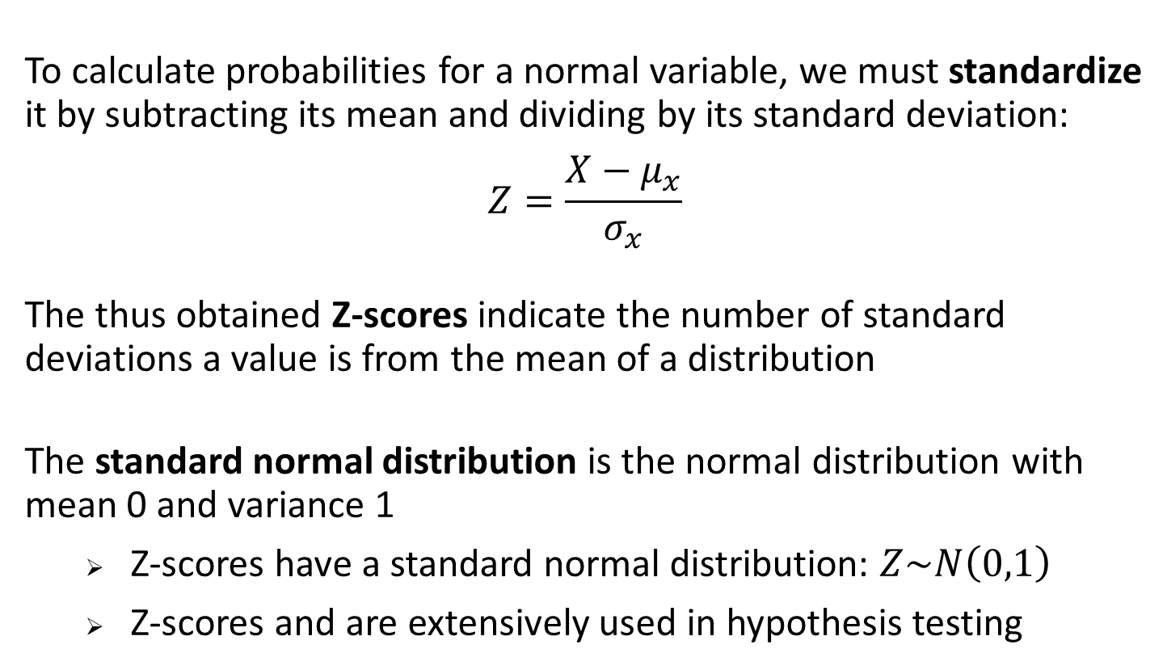
Standard Normal Distribution
To calculate probabilities for a normal variable, we must standardize it by subtracting its mean and dividing by its standard deviation:
$$Z=\frac{X−μ_{x}}{σ_{x}}$$
The thus obtained Z-scores indicate the number of standard deviations a value is from the mean of a distribution
The standard normal distribution is the normal distribution with mean 0 and variance 1
Z-scores have a standard normal distribution: $Z\sim N\left(0,1\right)$
Z-scores and are extensively used in hypothesis testing

Slide 32
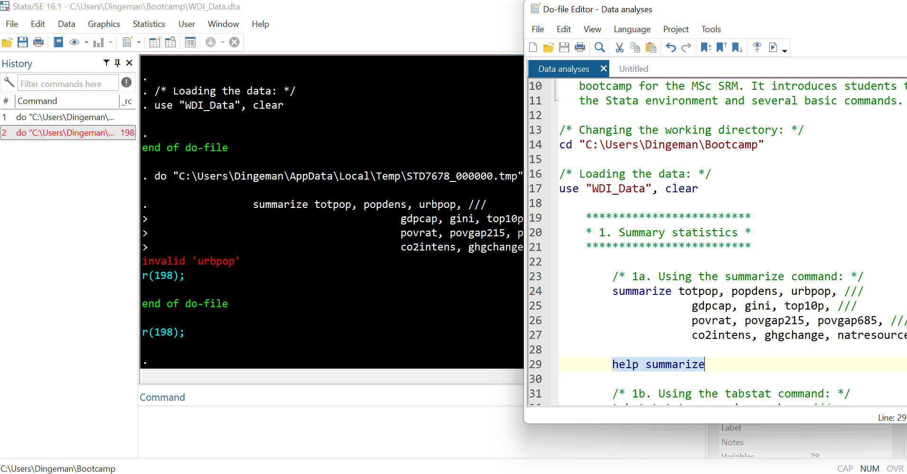
Stata Help Files Are Your Friend
If you forgot how a command works or receive an error message, access Stata’s help files by running: help …
(inserting the relevant command name)

Slide 33
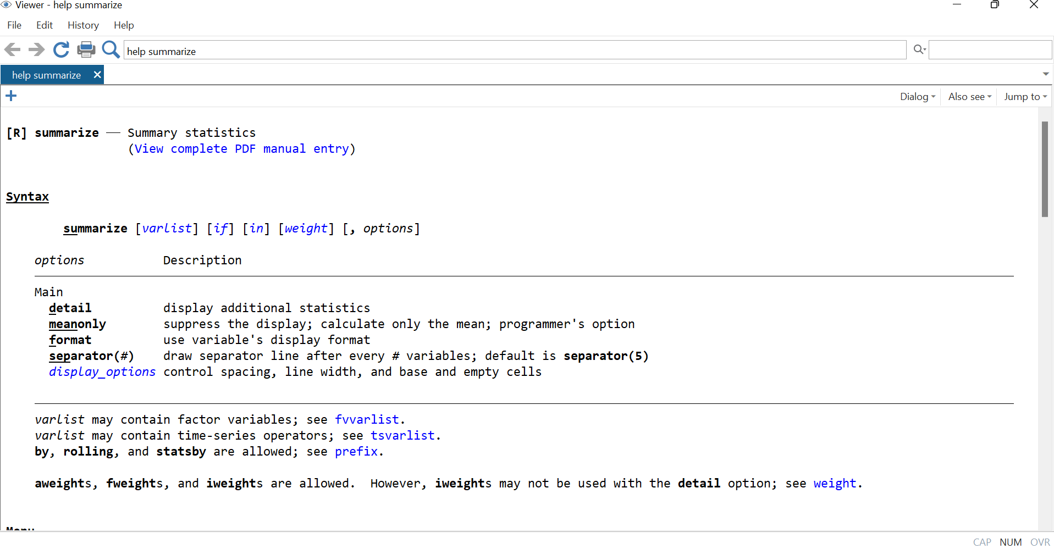
Stata Help Files Are Your Friend
Syntax section describes uses of command + how to specify them
See also the link to the Stata manual (with extended help)

Slide 34
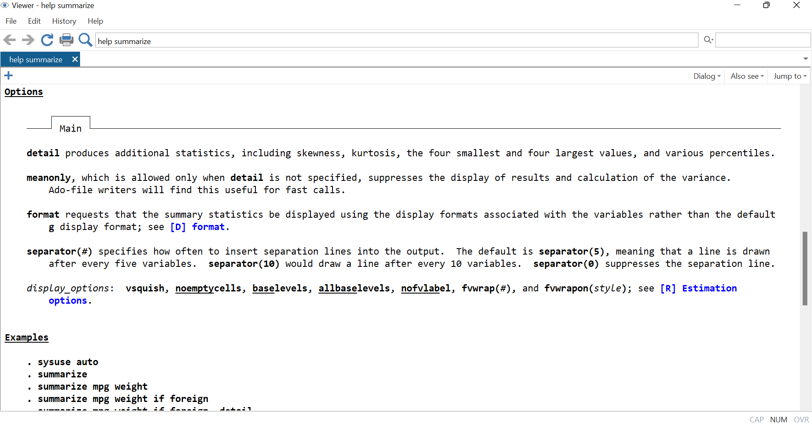
Stata Help Files Are Your Friend
Options section gives details about the options of the command
Examples section gives examples (extended ones in manual)

Slide 35
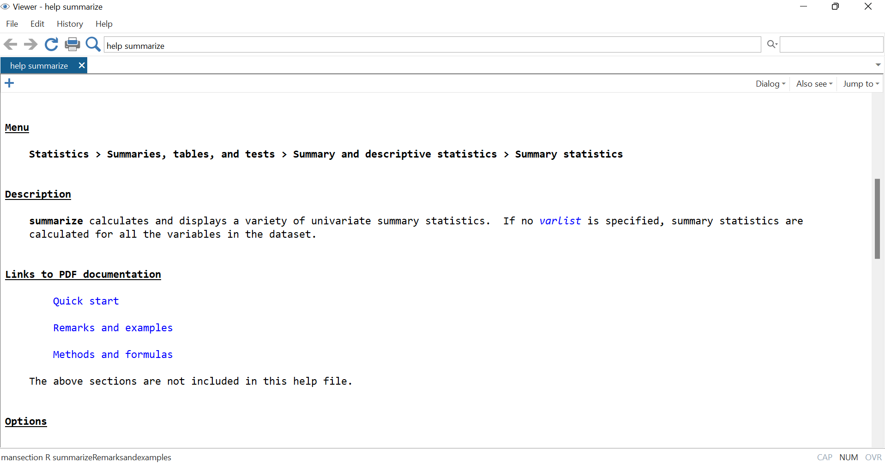
Stata Help Files Are Your Friend
Description section provides extended description of command
See also further links to Stata manual

Slide 36
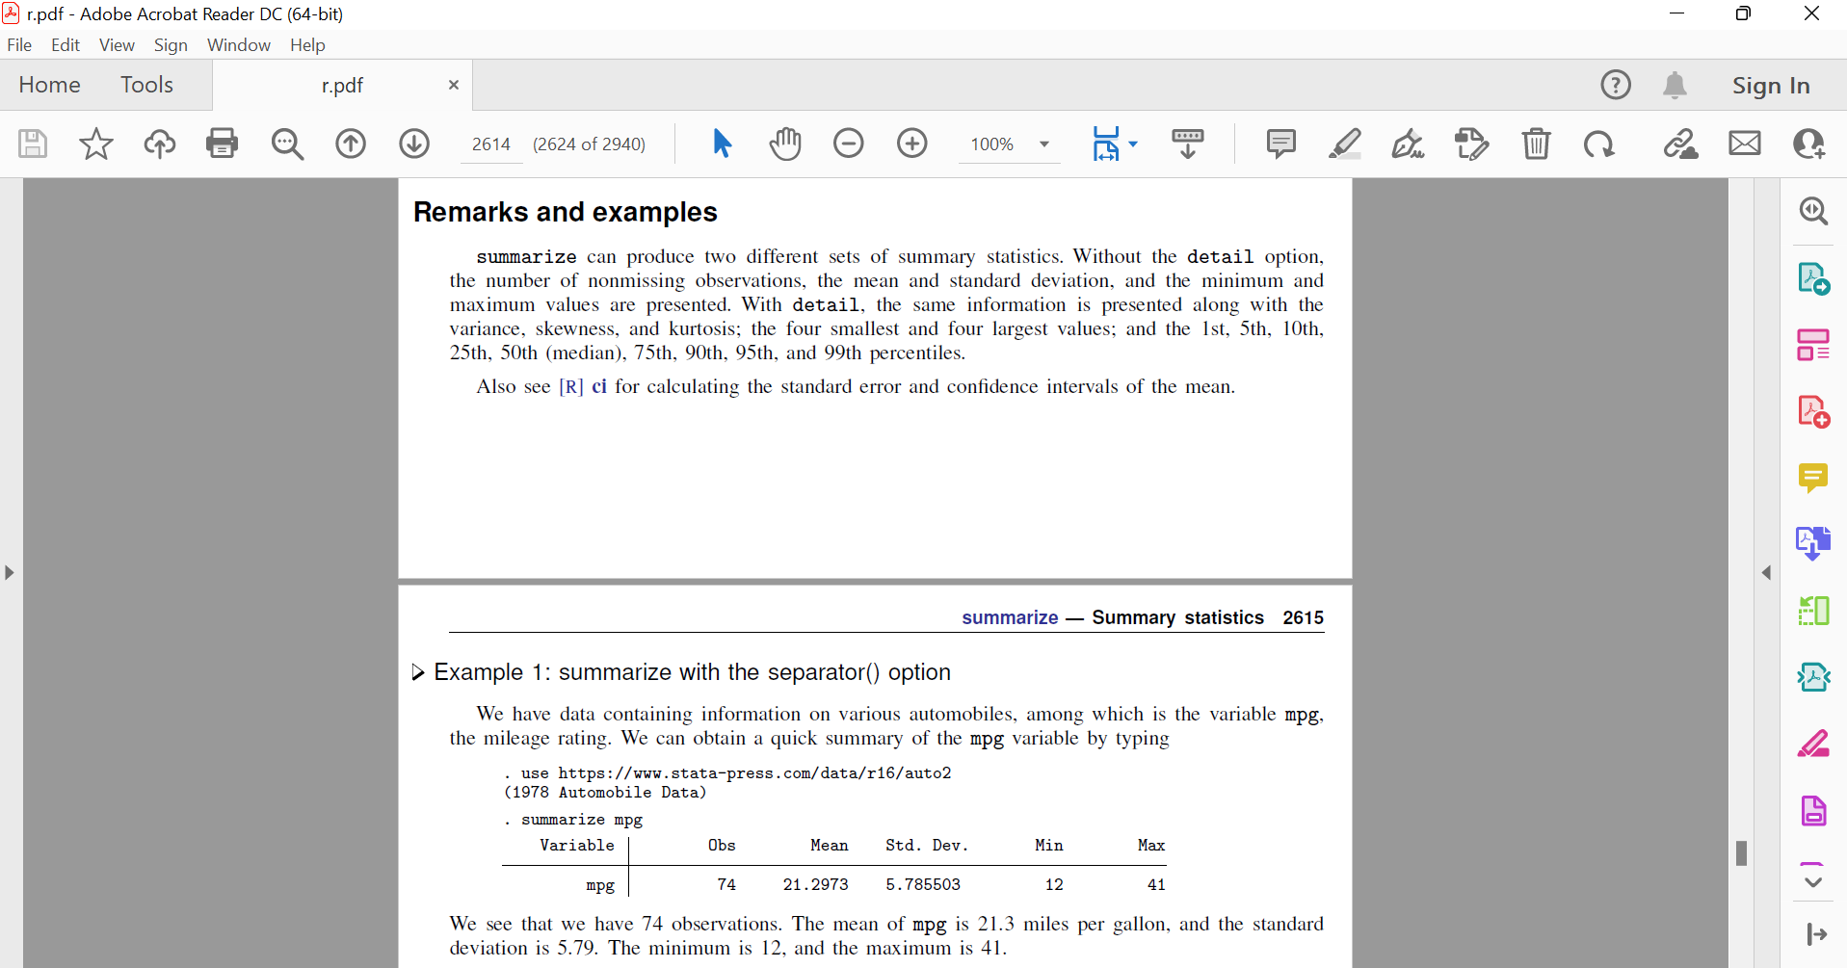
Stata Help Files Are Your Friend
The Stata manual is even more helpful than the help files
Other “friends”: Google and the Stata list (statlist.org)

Slide 37
General Stata Command Syntax
Stata commands mirror everyday commands in their structure:
They often start with a verb: “Bring me…”
They then list an object: “… a pint of milk…”
They may add a condition: “… if it is still before noon…”
They may specify further details about what needs to be done: “… and quickly please” or “… but I only want semi-skimmed”

Slide 38
General Stata Command Syntax
In nearly all cases, Stata syntax consists of four parts:
Command: What action do you want to see performed?
Names of variables, files, objects: On what objects is the command to be performed (“varlist”)
Qualifier(s) on observations: Which observations are to be taken into account (and how)? (“if”, “in”, “weight”)
Options: What special things should be done in the execution?
Part 1 is always there and Part 2 is most often also present

Slide 39
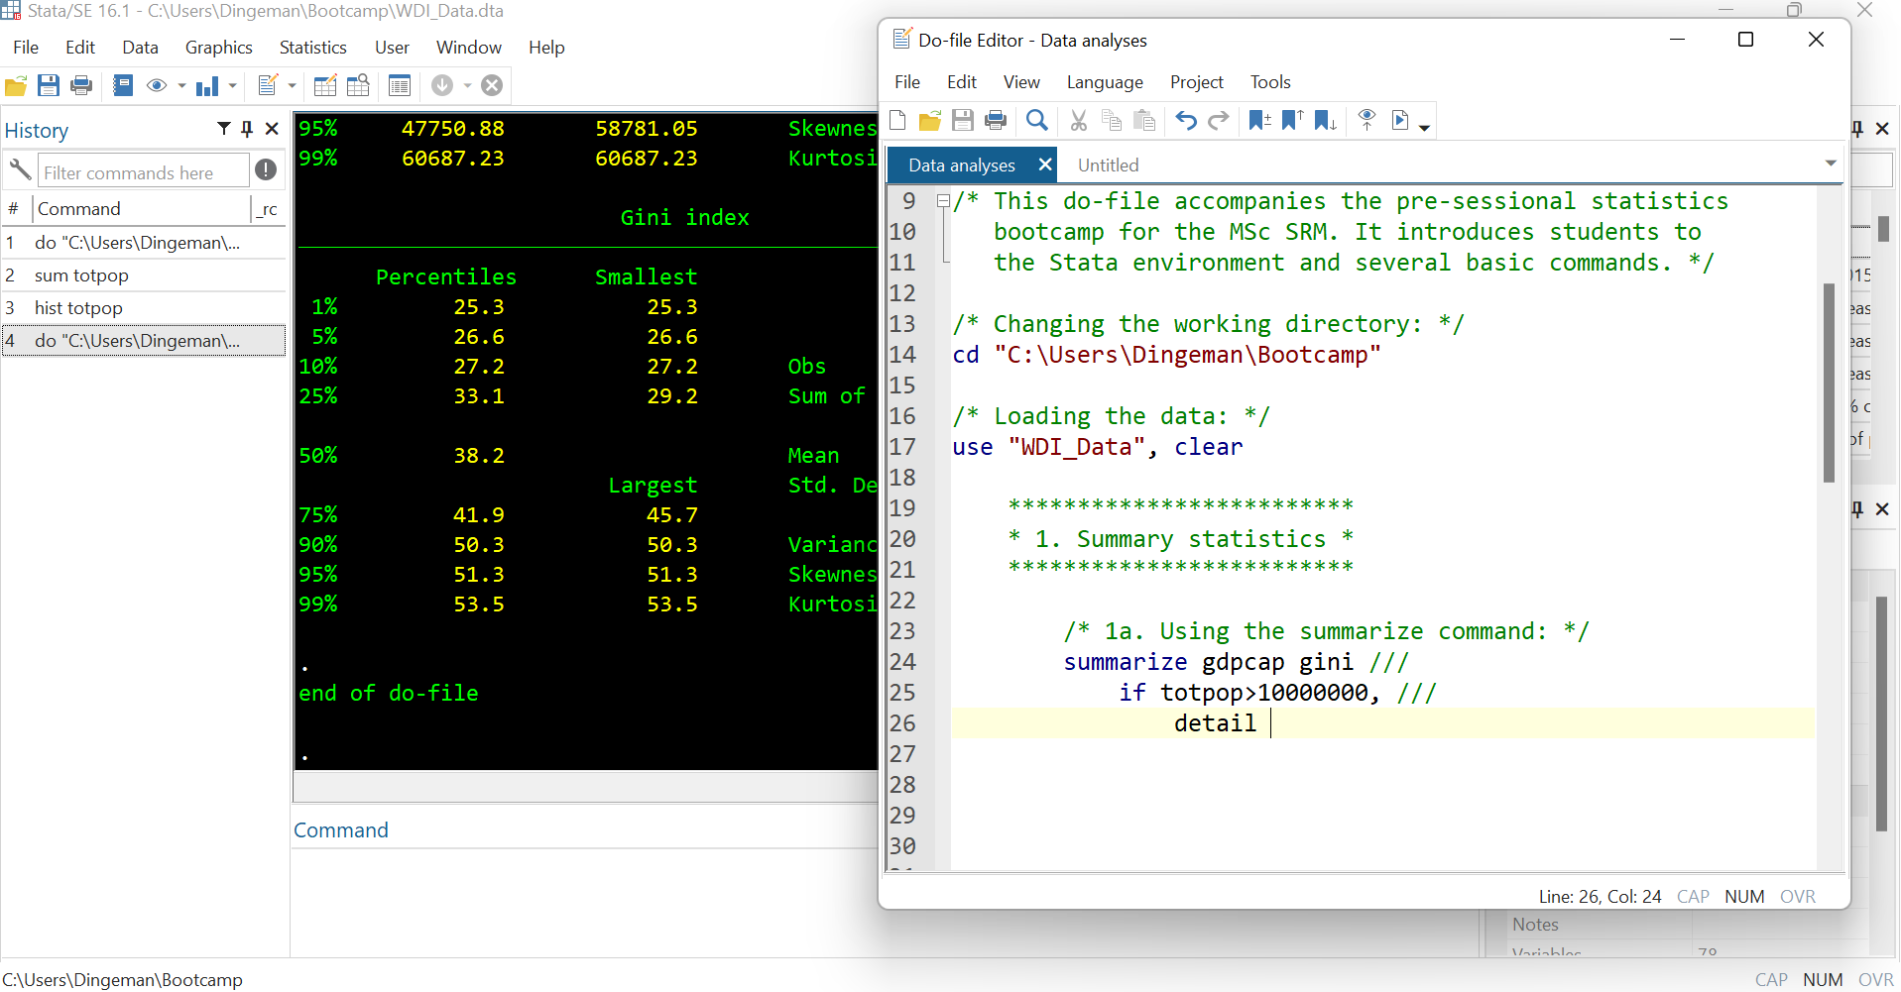
General Stata Command Syntax

Slide 40
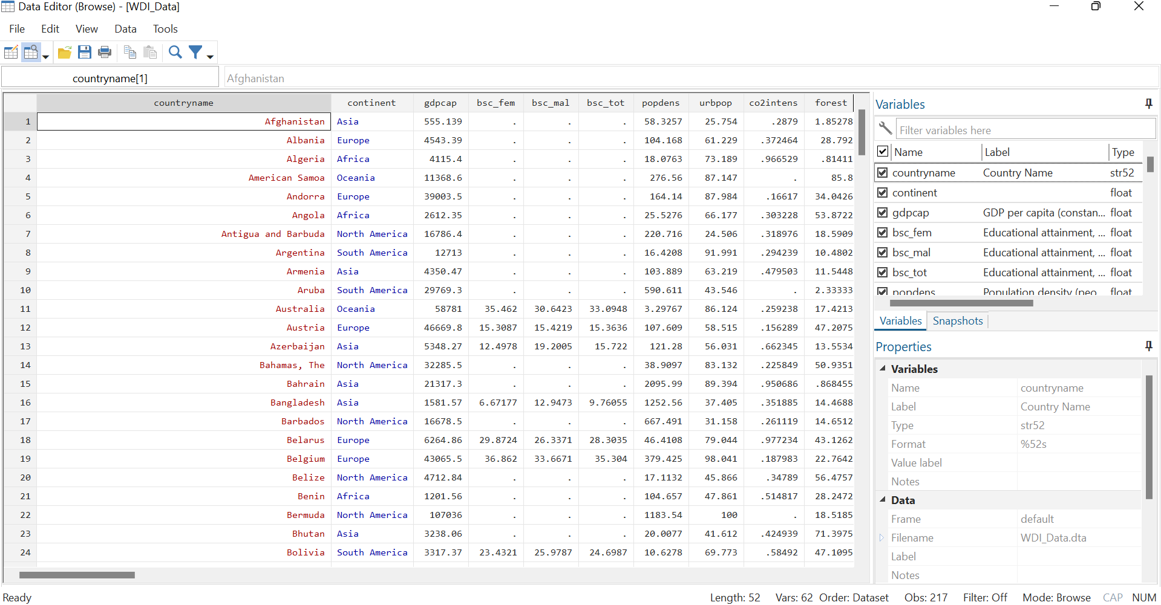
Viewing Your Dataset
To view all your data, simply run the command browse:
Black columns are numeric variables, red columns string variables, blue columns numeric variables with string labels

Slide 41
Viewing Your Dataset
To view all your data, simply run the command browse:
For numeric variables, missing values are recorded as “.”
For string variables, missing values are recorded as “ ”

Slide 42
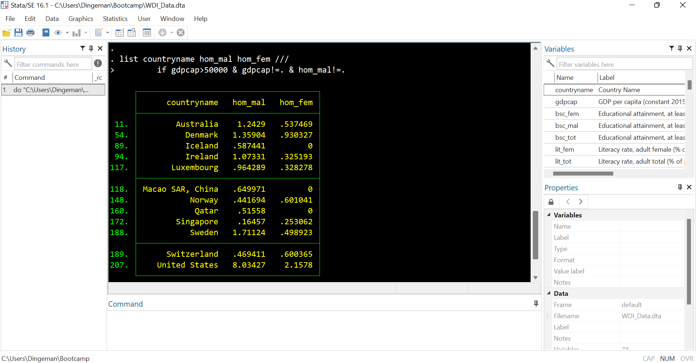
Viewing Your Dataset
You can also view (subsets of) your data using the list command:
In addition to or instead of “if”, you can also use “in”: e.g., list … in 1/20 selects the first 20 cases of the dataset

Slide 43
Stata’s Logical and Relational Operators
In “if” statements, you often need the following operators:
Operator | Meaning
== | is equal to
!= | is not equal to
> | greater than
< | smaller than
>= | greater or equal to
<= | smaller or equal to
& | and
| | or
Notes:
If you include string variables in “if” statements, make sure to put the specific values of the string variable between quotation marks:
E.g., list countryname gdpcap if countryname==“Zimbabwe”

Slide 44
Over to You Again…
Task: Pick a few variables (perhaps first run describe) and describe their distributions:
For numerical descriptions, use summarize
For visual descriptions, use histogram
Further instructions:
Run help commandname if you run into problems
Try to find the median of the variables
Try to change the look of the histograms
Consider low vs. high income countries separately
Consider Europe and another continent separately

Slide 45
Random Sampling and Sampling Distribution
Sampling theory plays a huge role in specifying the assumptions upon which our statistical inferences rely
We draw inferences from the sample about the population
Most statistical methods rely on averages or weighted averages of a sample of data
The values of the variables in our sample constitute random variables, and so any average we take of those values will also constitute a random variable

Slide 46
What If We Don’t Have a Simple Random Sample?
Simple random sample: every unit has an equal probability of being selected
I.e., selecting units from a population without replacement
Stratified random sample: the population is divided into strata (e.g., based on sex, ethnicity, region) and a simple random sample is drawn from each stratum
Convenience sample: chosen in a way convenient to the researcher, not at random from the population of interest
E.g., snowball sampling, or only selecting UCL students when one is really interested in the entire UK population

Slide 47
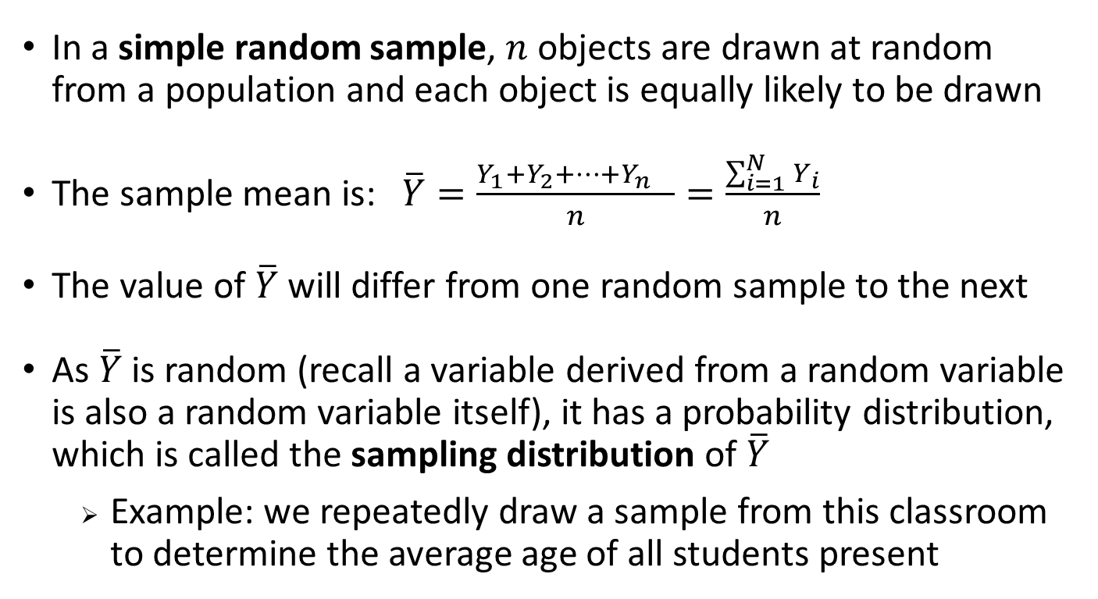
The Sampling Distribution of the Sample Mean
In a simple random sample, $n$ objects are drawn at random from a population and each object is equally likely to be drawn
The sample mean is: $\overline{Y}=\frac{Y_{1}+Y_{2}+…+Y_{n} }{n}=\frac{\sum_{i=1}^{N}{Y_{i}}}{n}$
The value of $\overline{Y}$ will differ from one random sample to the next
As $\overline{Y}$is random (recall a variable derived from a random variable is also a random variable itself), it has a probability distribution, which is called the sampling distribution of $\overline{Y}$
Example: we repeatedly draw a sample from this classroom to determine the average age of all students present

Slide 48
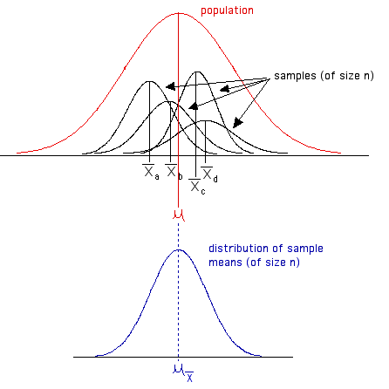
The Sampling Distribution of the Sample Mean
The sampling distribution gives an idea how much the values of the estimate (sample mean) might vary from sample to sample
Example: How much does the average age vary across repeated samples that we draw from this classroom?

Slide 49
The Sampling Distribution of the Sample Mean
The sampling distribution tells us something about the uncertainty in the estimate obtained from the one sample we actually observe
How predictive is the average age in our 1st classroom sample w.r.t. the underlying average age in the total classroom?

Slide 50
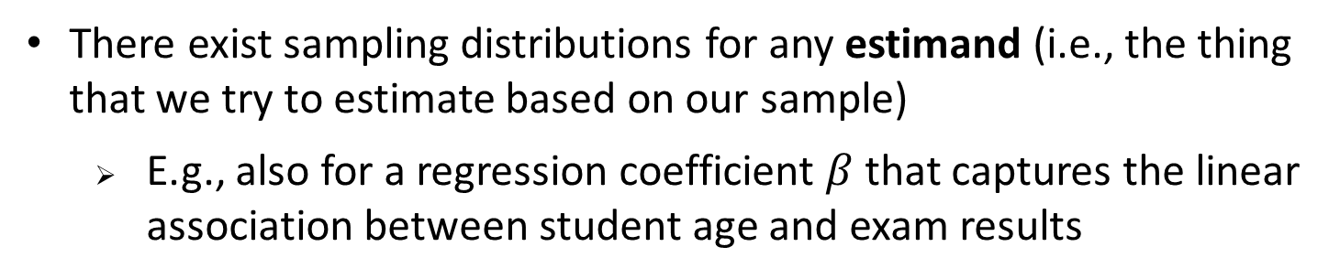
The Sampling Distribution of the Sample Mean
There exist sampling distributions for any estimand (i.e., the thing that we try to estimate based on our sample)
E.g., also for a regression coefficient $β$ that captures the linear association between student age and exam results

Slide 51
Hypothesis Testing
A theory is a tentative conjecture about the causes of some phenomenon of interest; once a theory has been developed, we can restate it into one or more testable hypotheses
E.g., girls read more books than boys and thus have better reading skills
A hypothesis is a theory-based statement about a relationship that we expect to observe
E.g., girls achieve higher scores than boys on reading tests
Theories and hypotheses both pertain to the population
E.g., we expect girls to be better readers across all students

Slide 52
Hypothesis Testing
A hypothesis is a theory-based statement about a relationship that we expect to observe
E.g., girls achieve higher scores than boys on reading tests
For every hypothesis there is a corresponding null hypothesis
About what we would expect if our theory is incorrect
E.g., there is no association between Y and X in the population
In our example: girls are not better readers than boys

Slide 53
The Logic of Hypothesis Testing
We have a coin we suspect may be biased in favour of heads
How would we decide whether it is indeed biased?
We try tossing it 10 times (i.e., we draw a sample), and we find that it comes up heads 8 times
We formulate our null hypothesis that the coin is fair, and ask:
What is the probability that we would see 8 or more heads in ten tosses if this coin is indeed fair?
H₀ = coin is fair,
H₁ = coin is biased in favour of heads

Slide 54
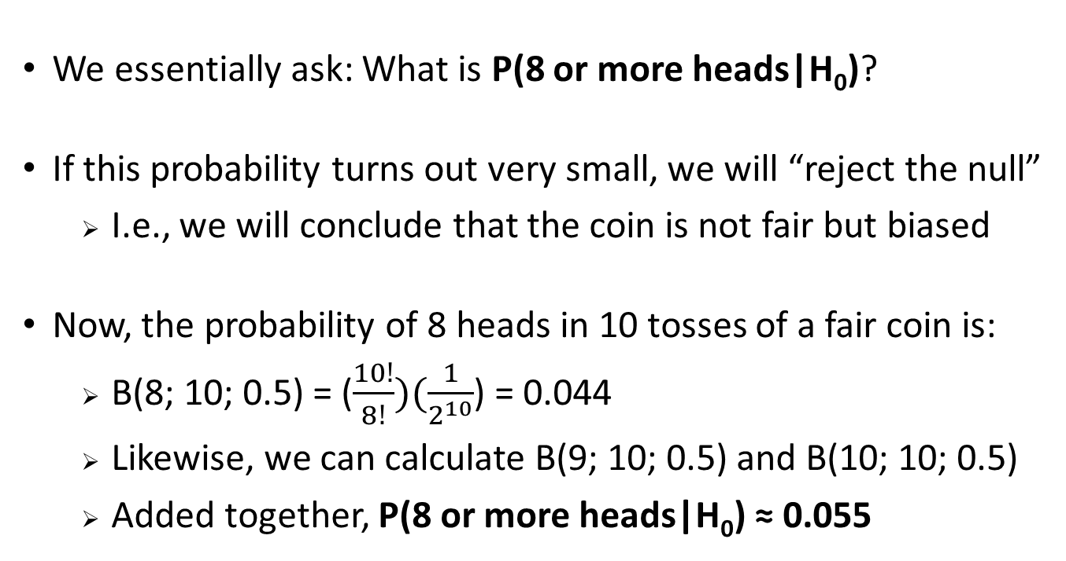
The Logic of Hypothesis Testing
We essentially ask: What is P(8 or more heads|H₀)?
If this probability turns out very small, we will “reject the null”
I.e., we will conclude that the coin is not fair but biased
Now, the probability of 8 heads in 10 tosses of a fair coin is:
B(8; 10; 0.5) = ($\frac{10!}{8!})(\frac{1}{2^{10}}$) = 0.044
Likewise, we can calculate B(9; 10; 0.5) and B(10; 10; 0.5)
Added together, P(8 or more heads|H₀) ≈ 0.055

Slide 55
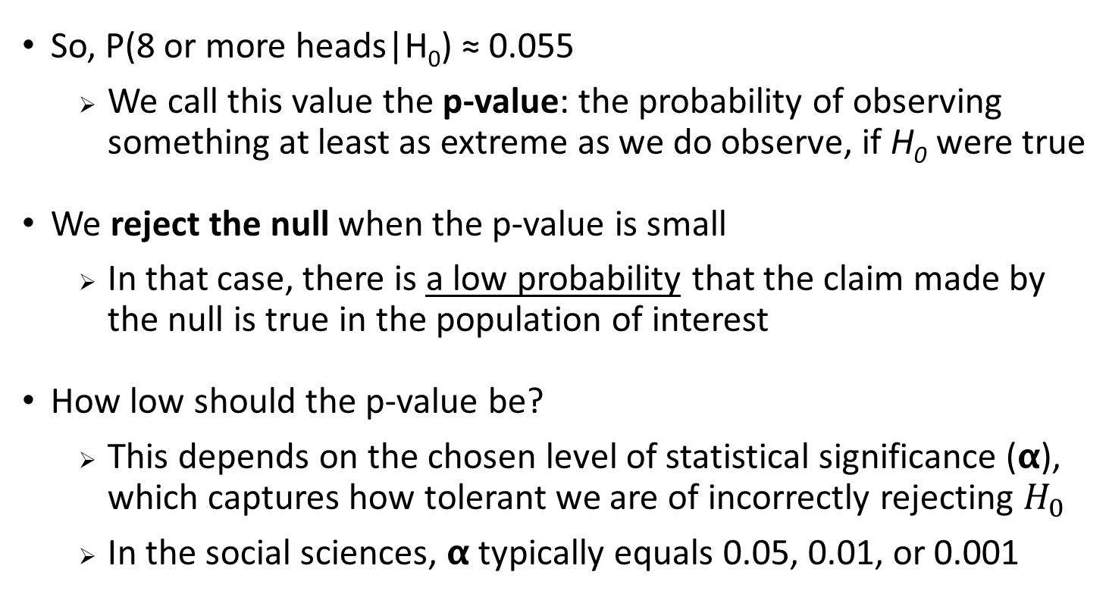
The Logic of Hypothesis Testing
So, P(8 or more heads|H₀) ≈ 0.055
We call this value the p-value: the probability of observing something at least as extreme as we do observe, if H₀ were true
We reject the null when the p-value is small
In that case, there is a low probability that the claim made by the null is true in the population of interest
How low should the p-value be?
This depends on the chosen level of statistical significance (𝝰), which captures how tolerant we are of incorrectly rejecting $H_{0}$
In the social sciences, 𝝰 typically equals 0.05, 0.01, or 0.001

Slide 56
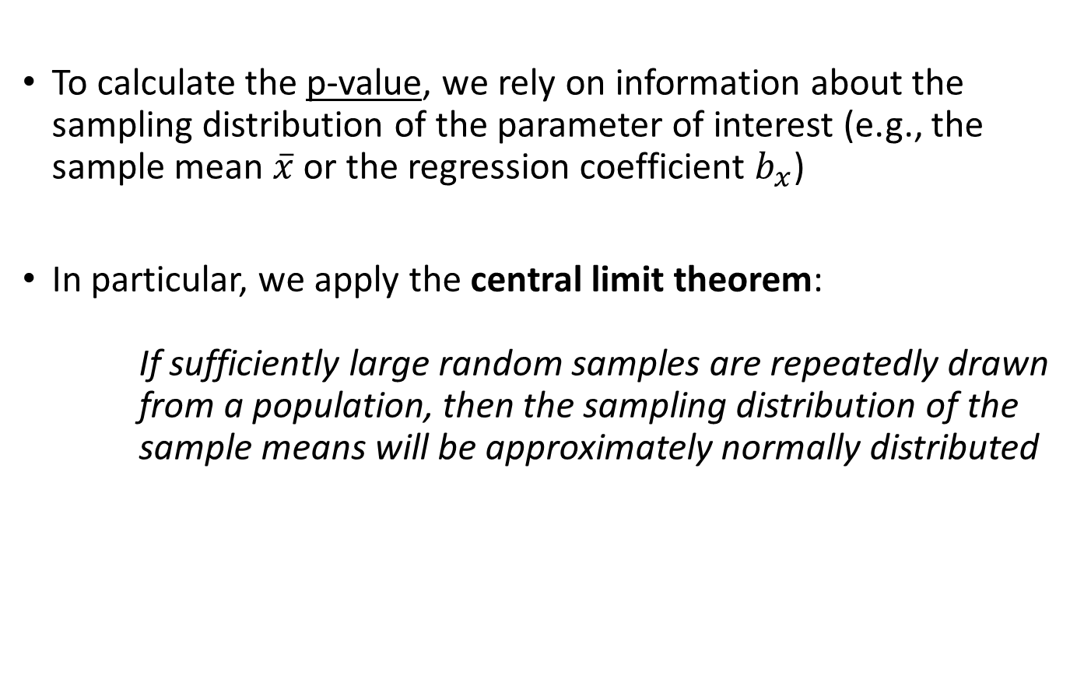
Hypothesis Testing: Central Limit Theorem
To calculate the p-value, we rely on information about the sampling distribution of the parameter of interest (e.g., the sample mean $\overline{x}$ or the regression coefficient $b_{x}$)
In particular, we apply the central limit theorem:
If sufficiently large random samples are repeatedly drawn from a population, then the sampling distribution of the sample means will be approximately normally distributed
Sample sizes of N ≥ 30 are typically large enough

Slide 57
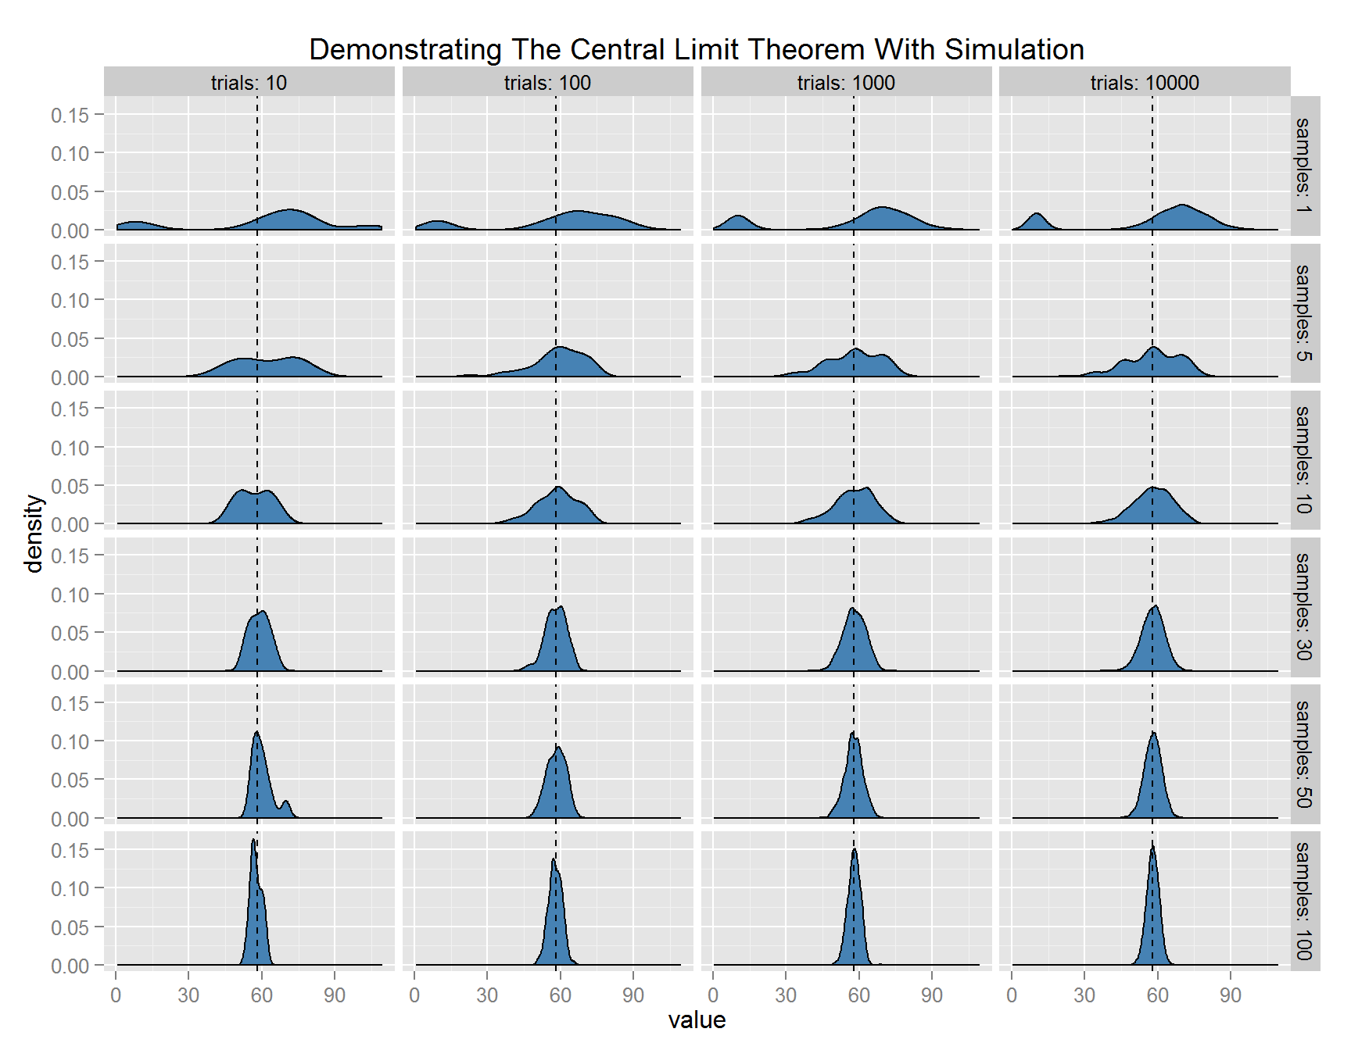
Hypothesis Testing: Central Limit Theorem
If sufficiently large random samples are repeatedly drawn from a population, then the sampling distribution of the sample means will be approximately normally distributed → An illustration:
Notes:
In the rows of this graph, you see the size of each individual sample.
In the columns of this graph, you see how many times we draw a sample of a specific size.
E.g., in the top-left cell, we draw 10 samples that each consist of 1 observation;
in the top-right cell, we draw 10,000 samples that each consist of 1 observation;
in the bottom-right call, we draw 10,000 samples that each consist of 100 observations.
You can see that, for samples with N≥30, we end up with approximately normal sampling distributions in the right-most column (i.e., when we take repeated samples of this size).

Slide 58
Hypothesis Testing: Central Limit Theorem
Implication central limit theorem:
If we take repeated samples from a population, the means from those samples will fall in a normal distribution around the population mean
This principle is used in hypothesis testing to calculate the p-value:
Applying this principle, we can determine the probability of observing what we do observe in our sample if the null hypothesis about the underlying population was true

Slide 59
Hypothesis Testing: Type of Errors
In hypothesis testing, we can make two types of errors:
Type-I error (false positive): rejecting H₀ when it is true
Covid test says you have got the virus even though you don’t
Type-II error (false negative): not rejecting H₀ when it is false
Covid test says you don’t have the virus even though you do
There is a trade-off between avoiding Type-I and Type-II errors

Slide 60
Hypothesis Testing: Type of Errors
In hypothesis testing, we can make two types of errors:
Type-I error (false positive): rejecting H₀ when it is true
Type-II error (false negative): not rejecting H₀ when it is false
Hypothesis testing rules are constructed to make the probability of committing a Type-I error (false positive) fairly small
We define the significance level of a test (𝝰) as the probability of committing a Type-I error
E.g., 𝝰 = 0.05 implies that, with repeated sampling, we will incorrectly reject the null hypothesis 5% of the time
In the Covid test example: in 5% of cases, the test tells us that someone has Covid even though they don’t

Slide 61
Hypothesis Testing: Test Statistics
A test statistic is a single number that quantifies the difference between the observed data in our sample, and the expected data under the null hypothesis
E.g., it compares a sample mean to the hypothesised population mean, or a sample regression coefficient to the assumed population regression coefficient
Examples of test statistics: χ², F, T, Z
The test statistic that should be used in a given test depends on the type of analysis

Slide 62
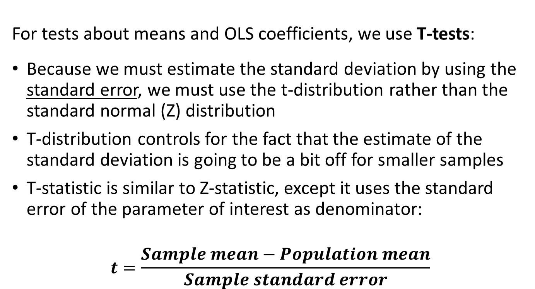
T-test
For tests about means and OLS coefficients, we use T-tests:
Because we must estimate the standard deviation by using the standard error, we must use the t-distribution rather than the standard normal (Z) distribution
T-distribution controls for the fact that the estimate of the standard deviation is going to be a bit off for smaller samples
T-statistic is similar to Z-statistic, except it uses the standard error of the parameter of interest as denominator:
$$t=\frac{Sample mean−Population mean}{Sample standard error}$$

Slide 63
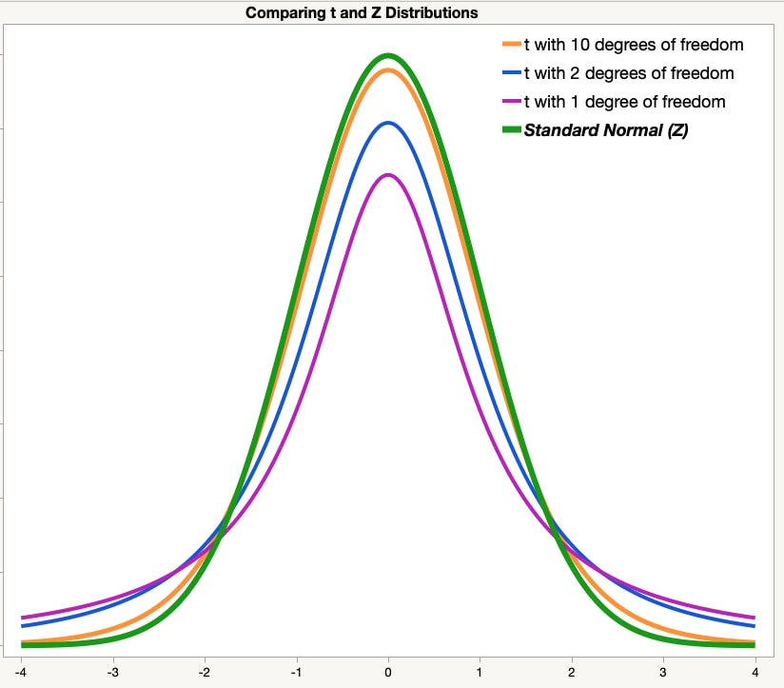
T-test
For tests about means and OLS coefficients, we use T-tests:
T-distribution looks like a standard normal distribution but it has fatter tails (and degrees of freedom attached to it)
T-distribution will be flatter in smaller samples, but it approximates the Z-distribution as sample size increases

Slide 64
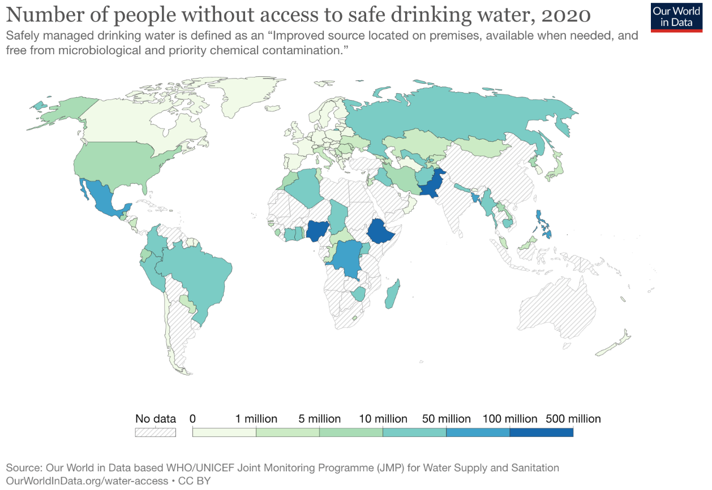
Hypothesis Testing: Stata Example
Testable statement:
People who live in higher-income countries and lower-income countries do not have equal access to safe drinking water

Slide 65
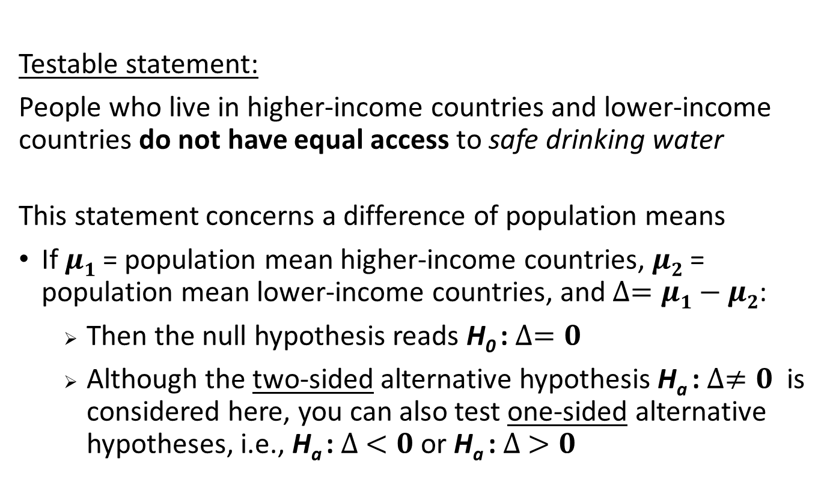
Hypothesis Testing: Stata Example
Testable statement:
People who live in higher-income countries and lower-income countries do not have equal access to safe drinking water
This statement concerns a difference of population means
If $μ1$ = population mean higher-income countries, $μ2$ = population mean lower-income countries, and $∆=μ1−μ2$:
Then the null hypothesis reads H₀ : $∆=0$
Although the two-sided alternative hypothesis H_{a} : $∆≠0$is considered here, you can also test one-sided alternative hypotheses, i.e., H_{a} : $∆ <0$or H_{a} : $∆ >0$

Slide 66
Hypothesis Testing: Stata Example
Before going ahead with our test, we first need to group countries into higher-income and lower-income ones
We can create a variable for this, which equals 0 for lower-income countries and 1 for higher-income countries
We use the generate and replace commands for this:
generate high_income = 0
replace high_income = 1 if gdpcap > 12695
replace high_income = . if gdpcap == .
generate creates completely new variables, replace changes the values of existing variables

Slide 67
Hypothesis Testing: Stata Example
Before going ahead with our test, we first need to group countries into higher-income and lower-income ones
We can create a variable for this, which equals 0 for lower-income countries and 1 for higher-income countries
It is always important to check your data manipulations; here we can use tabulate and/or summarize for this:
tabulate gdpcap high_income
summarize gdpcap if high_income == 0
summarize gdpcap if high_income == 1

Slide 68
Hypothesis Testing: Stata Example
Before going ahead with our test, we first need to group countries into higher-income and lower-income ones
We can create a variable for this, which equals 0 for lower-income countries and 1 for higher-income countries
It is also smart to attach informative labels to new variables:
label variable high_income ///
"Whether country is higher-income"
label define HIGH_INCOME ///
0 "Lower-income country" ///
1 "Higher-income country"
label values high_income HIGH_INCOME

Slide 69
Hypothesis Testing: Stata Example
Remember to check the Stata help files for more information on the set-up, syntax, and working of these commands, e.g.:
help generate
help tabulate
help label
Bonus item:
Another way to construct the same grouping variable based on income level is with the recode command. Have a look at the help file for recode and see whether you can reproduce the “high_income” variable using recode.

Slide 70
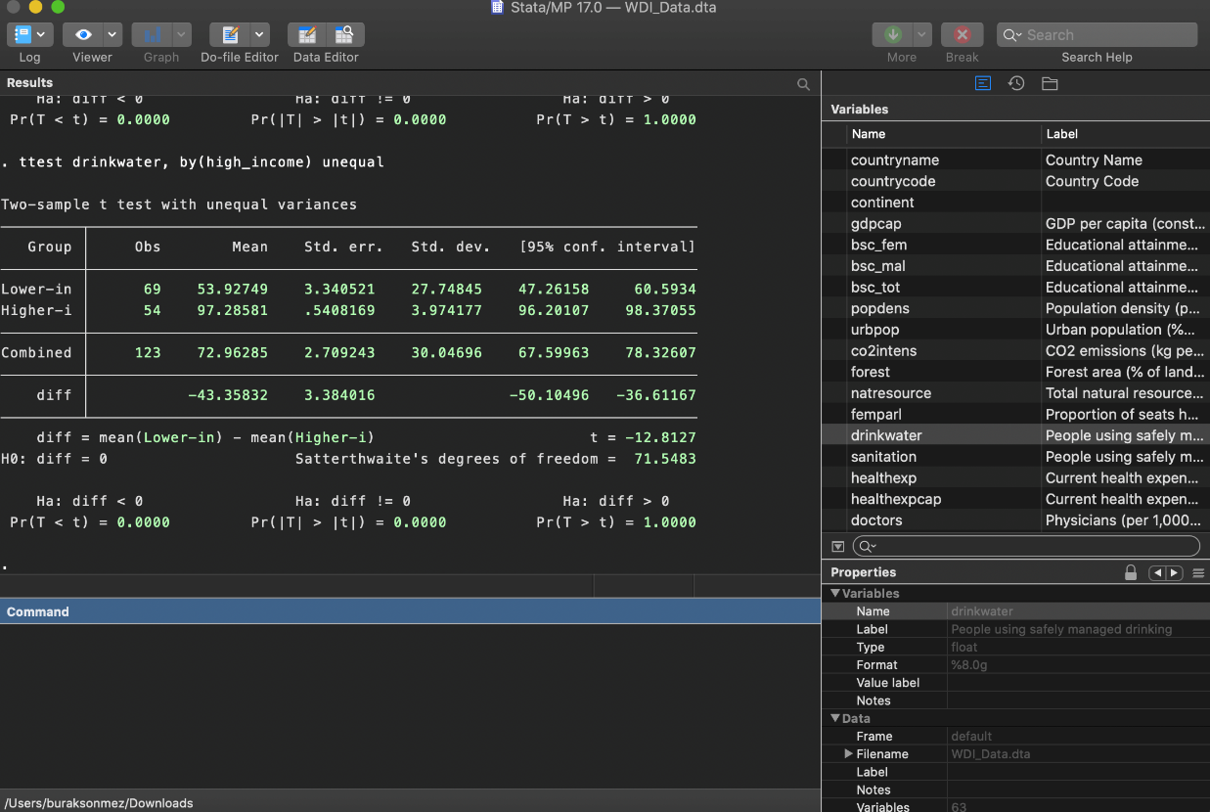
Hypothesis Testing: Stata Example
We can now conduct the t-test by running:
ttest drinkwater, by(high_income) unequal
See help ttest for details about this command
Notes:
The “unequal” option instructs Stata that we do not want to assume that the variance of the “drinkwater” variable is the same across both groups (i.e., the same for higher-income and lower-income countries).
If you leave out this option, Stata will assume that the variance for both groups is the same. In practice, it is usually more prudent / conservative to not make this assumption of equal variances across groups.

Slide 71
Hypothesis Testing: Stata Example
Key questions to answer:
If in the population there was no association between a country’s income level and access to safe drinking water, what are the chances of observing the group means that we do observe in our sample data?
In other words, what is the probability of observing a group mean difference of at least 43 percentage points if in reality there is no difference between these two groups?
The t-value for the observed group mean difference is -12.8, and the p-value (i.e., the probability of observing something at least as extreme by pure chance if H₀ is true) is <0.0001

Slide 72
Hypothesis Testing: Stata Example
A graphical illustration of what we are testing:
What is the size of the red area in this graph?
T-distribution
-12.8 0 12.8

Slide 73
Hypothesis Testing: Stata Example
Conclusions that we can draw from this test:
Given that the p-value is smaller than 𝝰 (whether we set 𝝰 at 0.05, 0.01, or 0.001), we can reject the null that there is no association b/w a country’s income level and access to safe drinking water
It is extremely unlikely that we observe what we do in our sample data if in reality there was no difference in access to safe drinking water between higher-income and lower-income countries
In fact, if we set 𝝰 at 0.05, the critical t-value equals 1.96
This means that a t-value larger than 1.96 or smaller than -1.96 would already have been enough to reject the null hypothesis

Slide 74
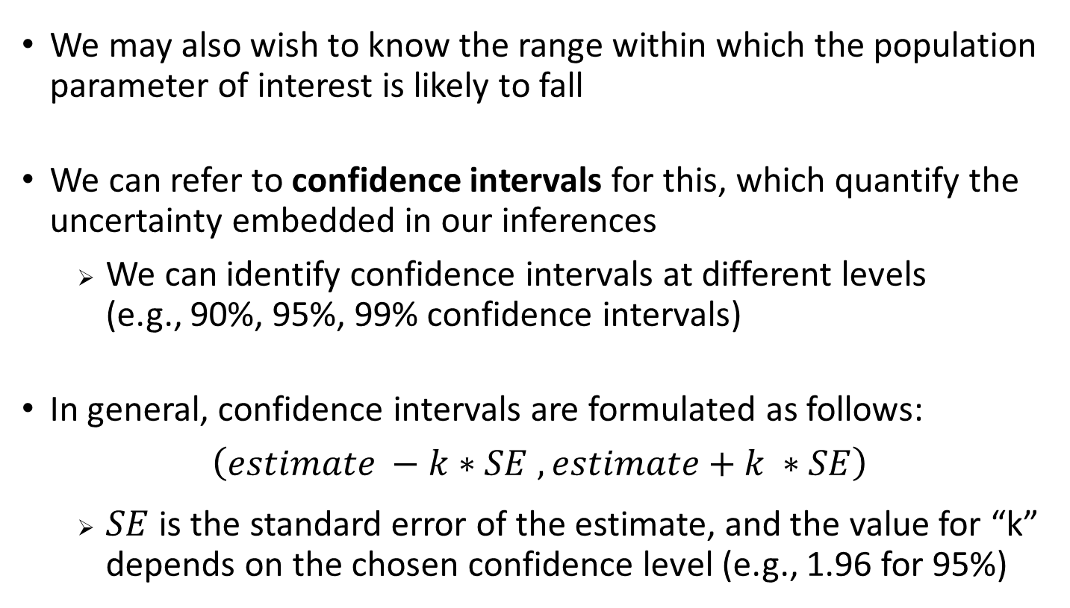
Uncertainty – Confidence Intervals
We may also wish to know the range within which the population parameter of interest is likely to fall
We can refer to confidence intervals for this, which quantify the uncertainty embedded in our inferences
We can identify confidence intervals at different levels (e.g., 90%, 95%, 99% confidence intervals)
In general, confidence intervals are formulated as follows:
$$\left(estimate −k∗SE , estimate+k ∗SE\right)$$
$SE$ is the standard error of the estimate, and the value for “k” depends on the chosen confidence level (e.g., 1.96 for 95%)

Slide 75
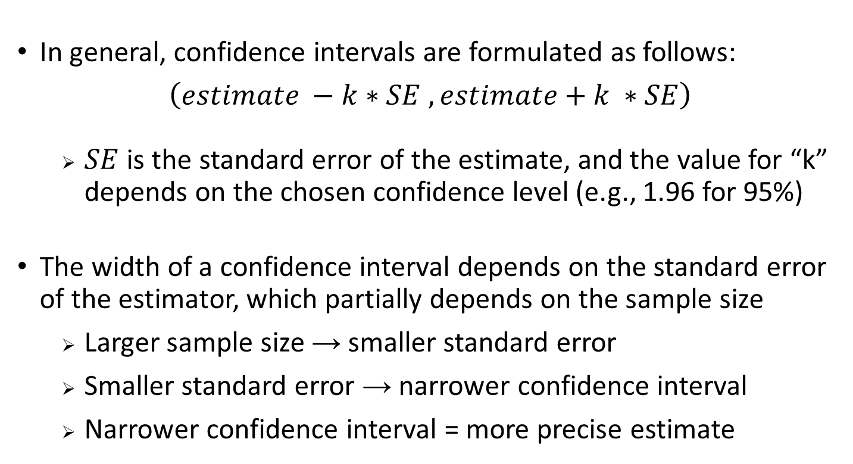
Uncertainty – Confidence Intervals
In general, confidence intervals are formulated as follows:
$$\left(estimate −k∗SE , estimate+k ∗SE\right)$$
$SE$ is the standard error of the estimate, and the value for “k” depends on the chosen confidence level (e.g., 1.96 for 95%)
The width of a confidence interval depends on the standard error of the estimator, which partially depends on the sample size
Larger sample size → smaller standard error
Smaller standard error → narrower confidence interval
Narrower confidence interval = more precise estimate

Slide 76
Uncertainty – Confidence Intervals
In our Stata example, the 95% confidence interval for the difference in access to safe drinking water for lower-income vs. higher-income countries is: (-50.1 ; 36.3)
What a 95% confidence interval tells us:
With repeated sampling, 95% of the confidence intervals calculated based on these samples will contain the population parameter of interest
What a 95% confidence interval does not tell us:
The population parameter of interest has a 95% probability of lying within the confidence interval that we have calculated based on this particular sample
Notes:
You can look at whether confidence intervals comprise certain values to conduct hypothesis tests.
E.g., in our example, the 95% confidence interval for the group mean difference does not comprise the value 0, so at the 95% confidence level (similar to α=0.05) we can reject the null hypothesis that the group mean difference equals 0.

Slide 77
Time for a Task…
Task: Conduct a similar t-test to compare two group means as in the example above, based on the WDI dataset
See help ttest if you are unsure about the command
As grouping variable, you can again use countries’ level of income, but for example also their continent, or a newly created grouping based on any other variable
Prior to conducting your test, form a hypothesis
Reflect on your results with a peer, paying attention to the observed difference in this dataset, and the accompanying p-value, t-value, and 95% confidence interval
If you have any spare time, conduct a second test

Slide 78
Understanding Associations
In everyday language, the terms dependence, association and correlation are used interchangeably
However, statistically, association is synonymous with dependence but different from correlation
Association is a general relationship: one variable provides information about another
Two variables are associated if there is a pattern in a scatter plot that is too strong to arise simply by chance
Correlation measures a specific form of association: two variables are correlated when there is a linear trend

Slide 79
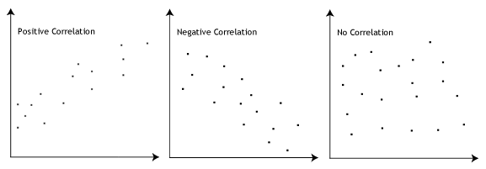
Understanding Associations

Slide 80
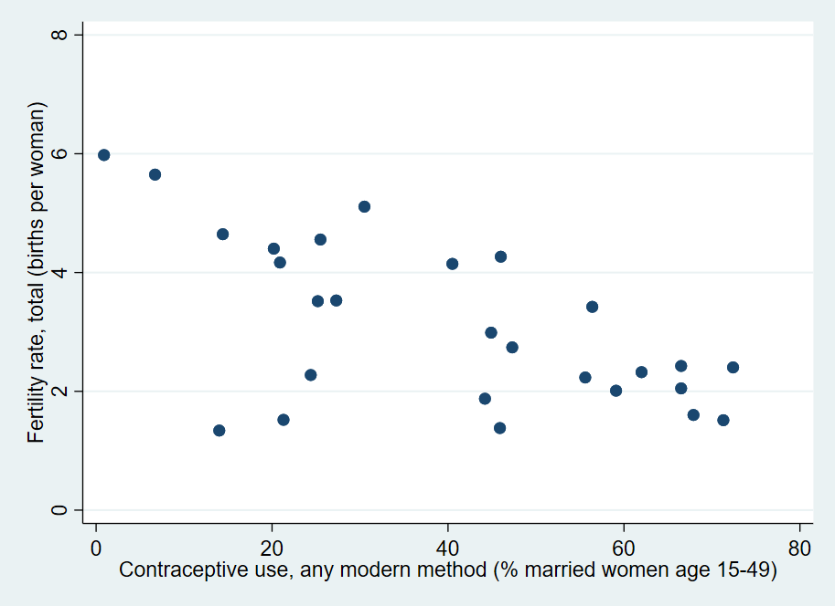
Understanding Associations
To create a scatter plot, use the scatter command
The first variable listed will be plotted along the vertical axis
The second variable will be plotted along the horizontal axis
E.g., scatter tfr contracep

Slide 81
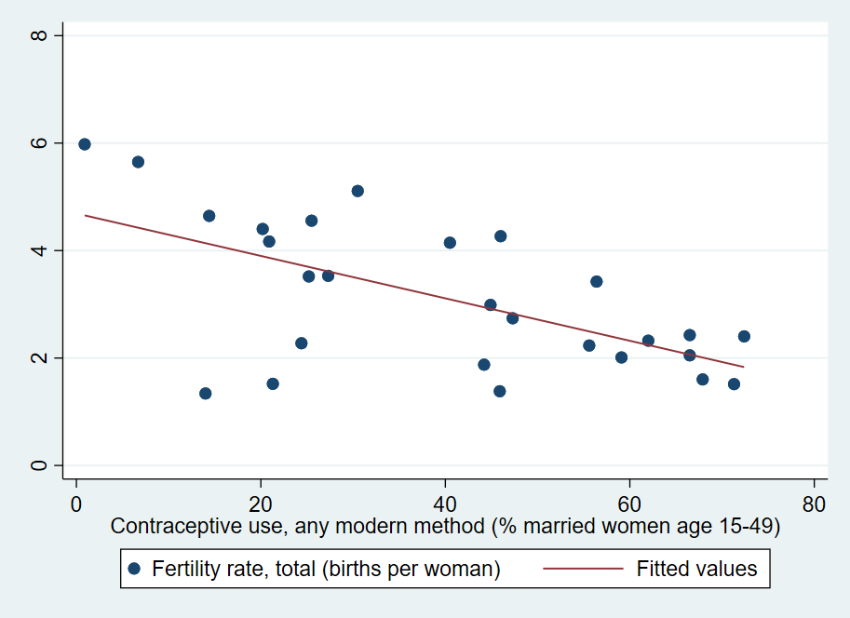
Understanding Associations
To create a scatter plot, use the scatter command
We can add another plot after specifying ||
E.g., we can add a best-fitting line using lfit:
scatter tfr contracep || lfit tfr contracep

Slide 82
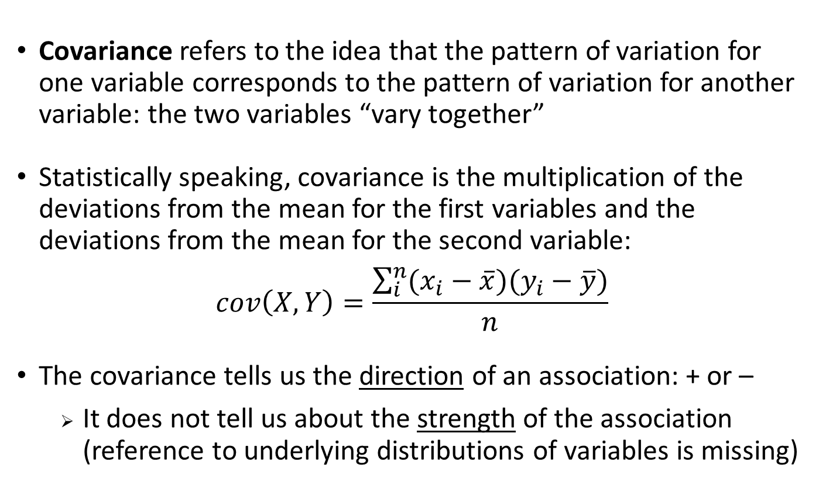
Covariance
Covariance refers to the idea that the pattern of variation for one variable corresponds to the pattern of variation for another variable: the two variables “vary together”
Statistically speaking, covariance is the multiplication of the deviations from the mean for the first variables and the deviations from the mean for the second variable:
$$cov\left(X,Y\right)=\frac{\sum_{i}^{n}{(x_{i}−\overline{x})(y_{i}−\overline{y})}}{n}$$
The covariance tells us the direction of an association: + or –
It does not tell us about the strength of the association (reference to underlying distributions of variables is missing)

Slide 83
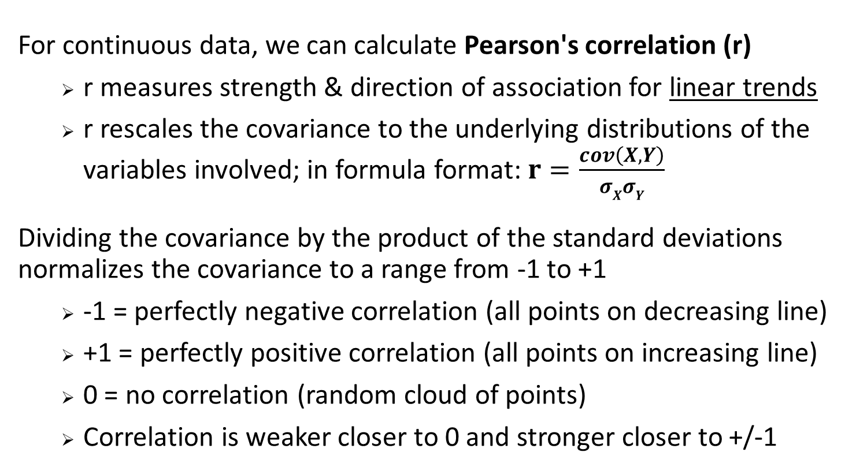
Pearson’s Correlation
For continuous data, we can calculate Pearson's correlation (r)
r measures strength & direction of association for linear trends
r rescales the covariance to the underlying distributions of the variables involved; in formula format: $r=\frac{cov\left(X,Y\right)}{σXσY}$
Dividing the covariance by the product of the standard deviations normalizes the covariance to a range from -1 to +1
-1 = perfectly negative correlation (all points on decreasing line)
+1 = perfectly positive correlation (all points on increasing line)
0 = no correlation (random cloud of points)
Correlation is weaker closer to 0 and stronger closer to +/-1

Slide 84
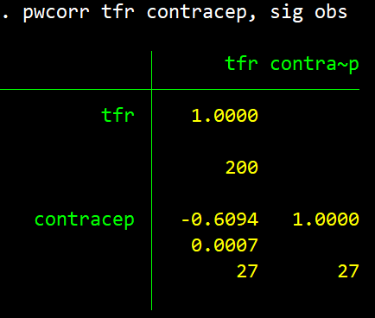
Pearson’s Correlation
In Stata, we can use the pwcorr command to get Pearson’s r:
E.g., pwcorr tfr contracep
pwcorr stands for “pairwise correlation”
We can add the options obs and sig to get the underlying number of observations and the p-value of the correlation
You can also obtain correlation coefficients for more than 2 variables add a time; you just extend the variable list for this

Slide 85
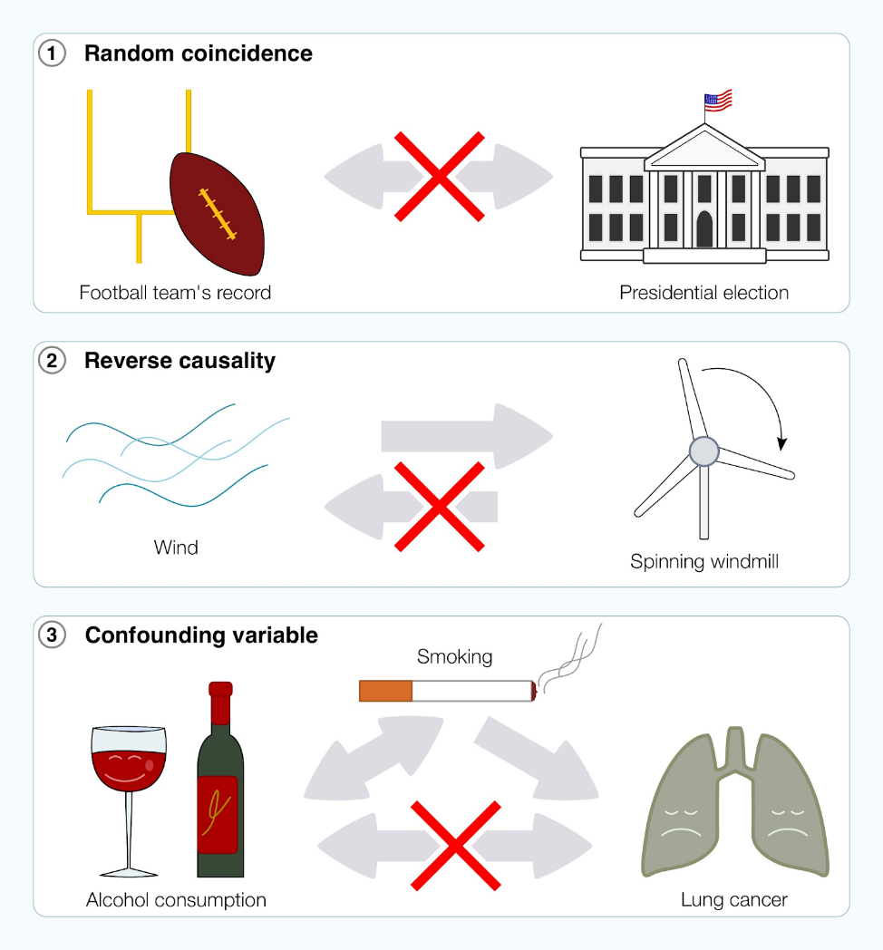
Spurious Correlations
Not all correlations reflect causal relationships:

Slide 86
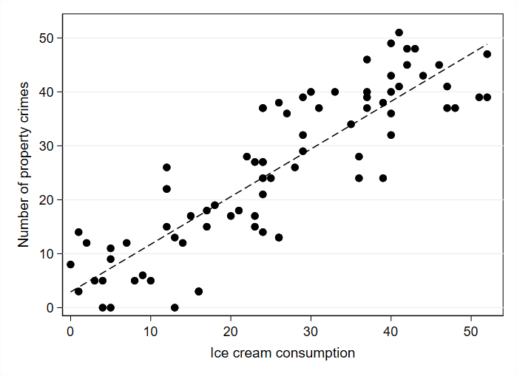
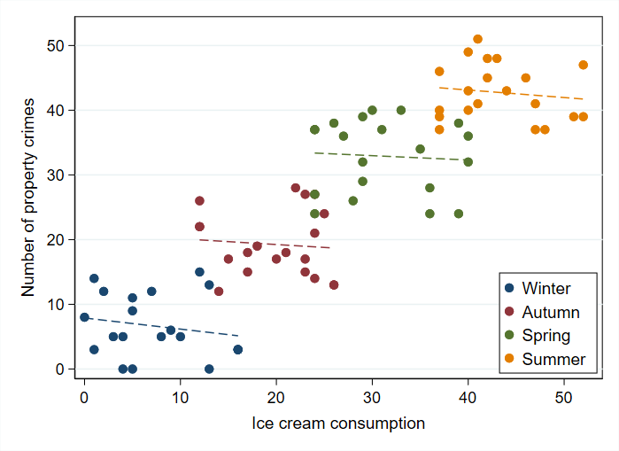
Spurious Correlations
Not all correlations reflect causal relationships:

Slide 87
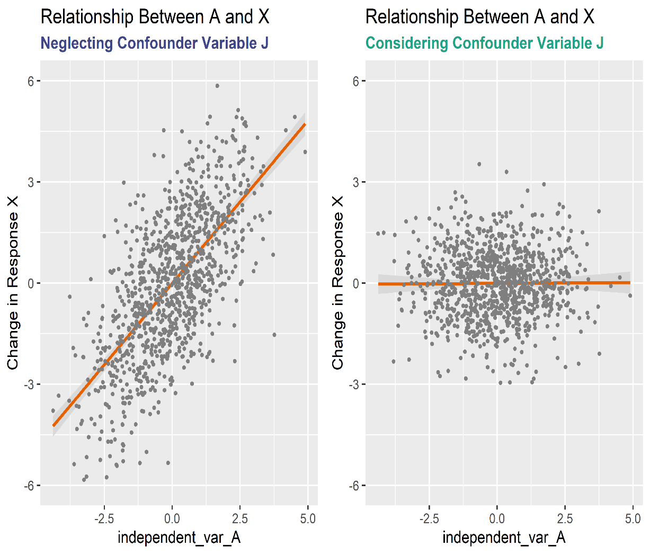
Spurious Correlations
Not all correlations reflect causal relationships:

Slide 88
Final Exercise
Task: Please go back to the WDI dataset and try to identify a potential spurious correlation
Report the correlation coefficient
Draw a scatter plot of the association
Explain why you think the relationship is not causal
Investigate how the association varies across different types of countries
You can apply “if” conditions and create new variables to group countries together

Slide 89
Questions
Please ask any remaining questions now or feel free to email us at b.sonmez@ucl.ac.uk or d.wiertz@ucl.ac.uk
Feedback on this bootcamp is also very welcome
Good luck with your MSc at UCL!

